Slide 1


Slide 2
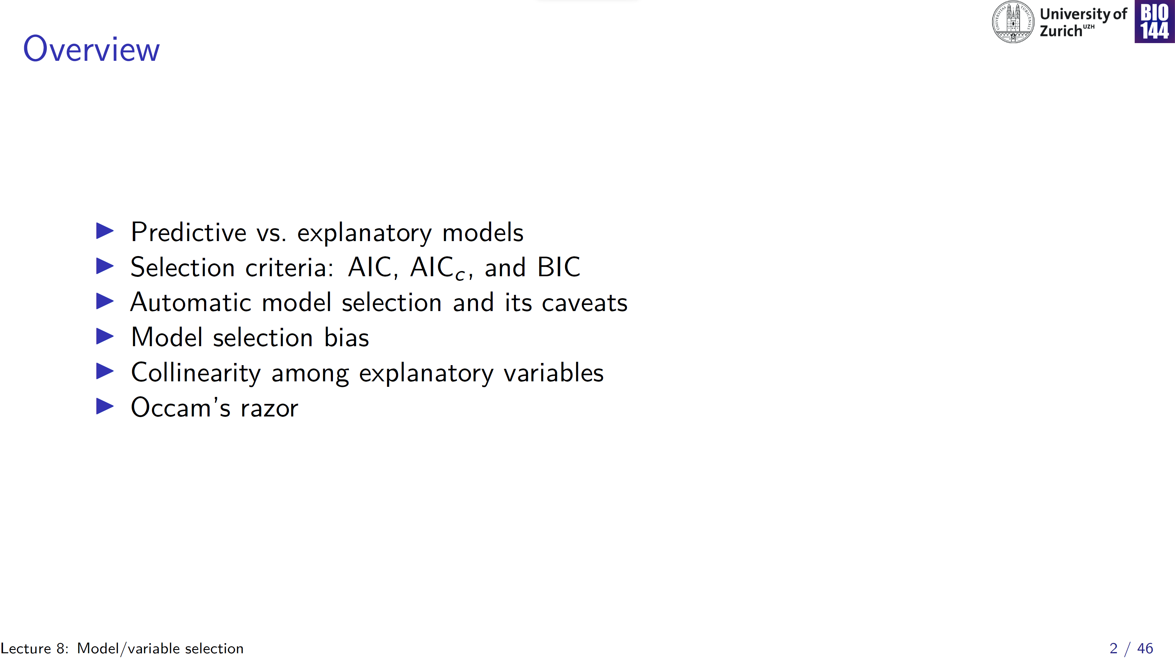
Predictive
→ Predict future values of y
Can use automated model selection
Collinearity not really an issue
Statistical model
Confirmatory
→ Test hypotheses
Explanatory
Exploratory
→ Generate hypotheses
Don’t use automated model selection
Collinearity a potential issue

Slide 3
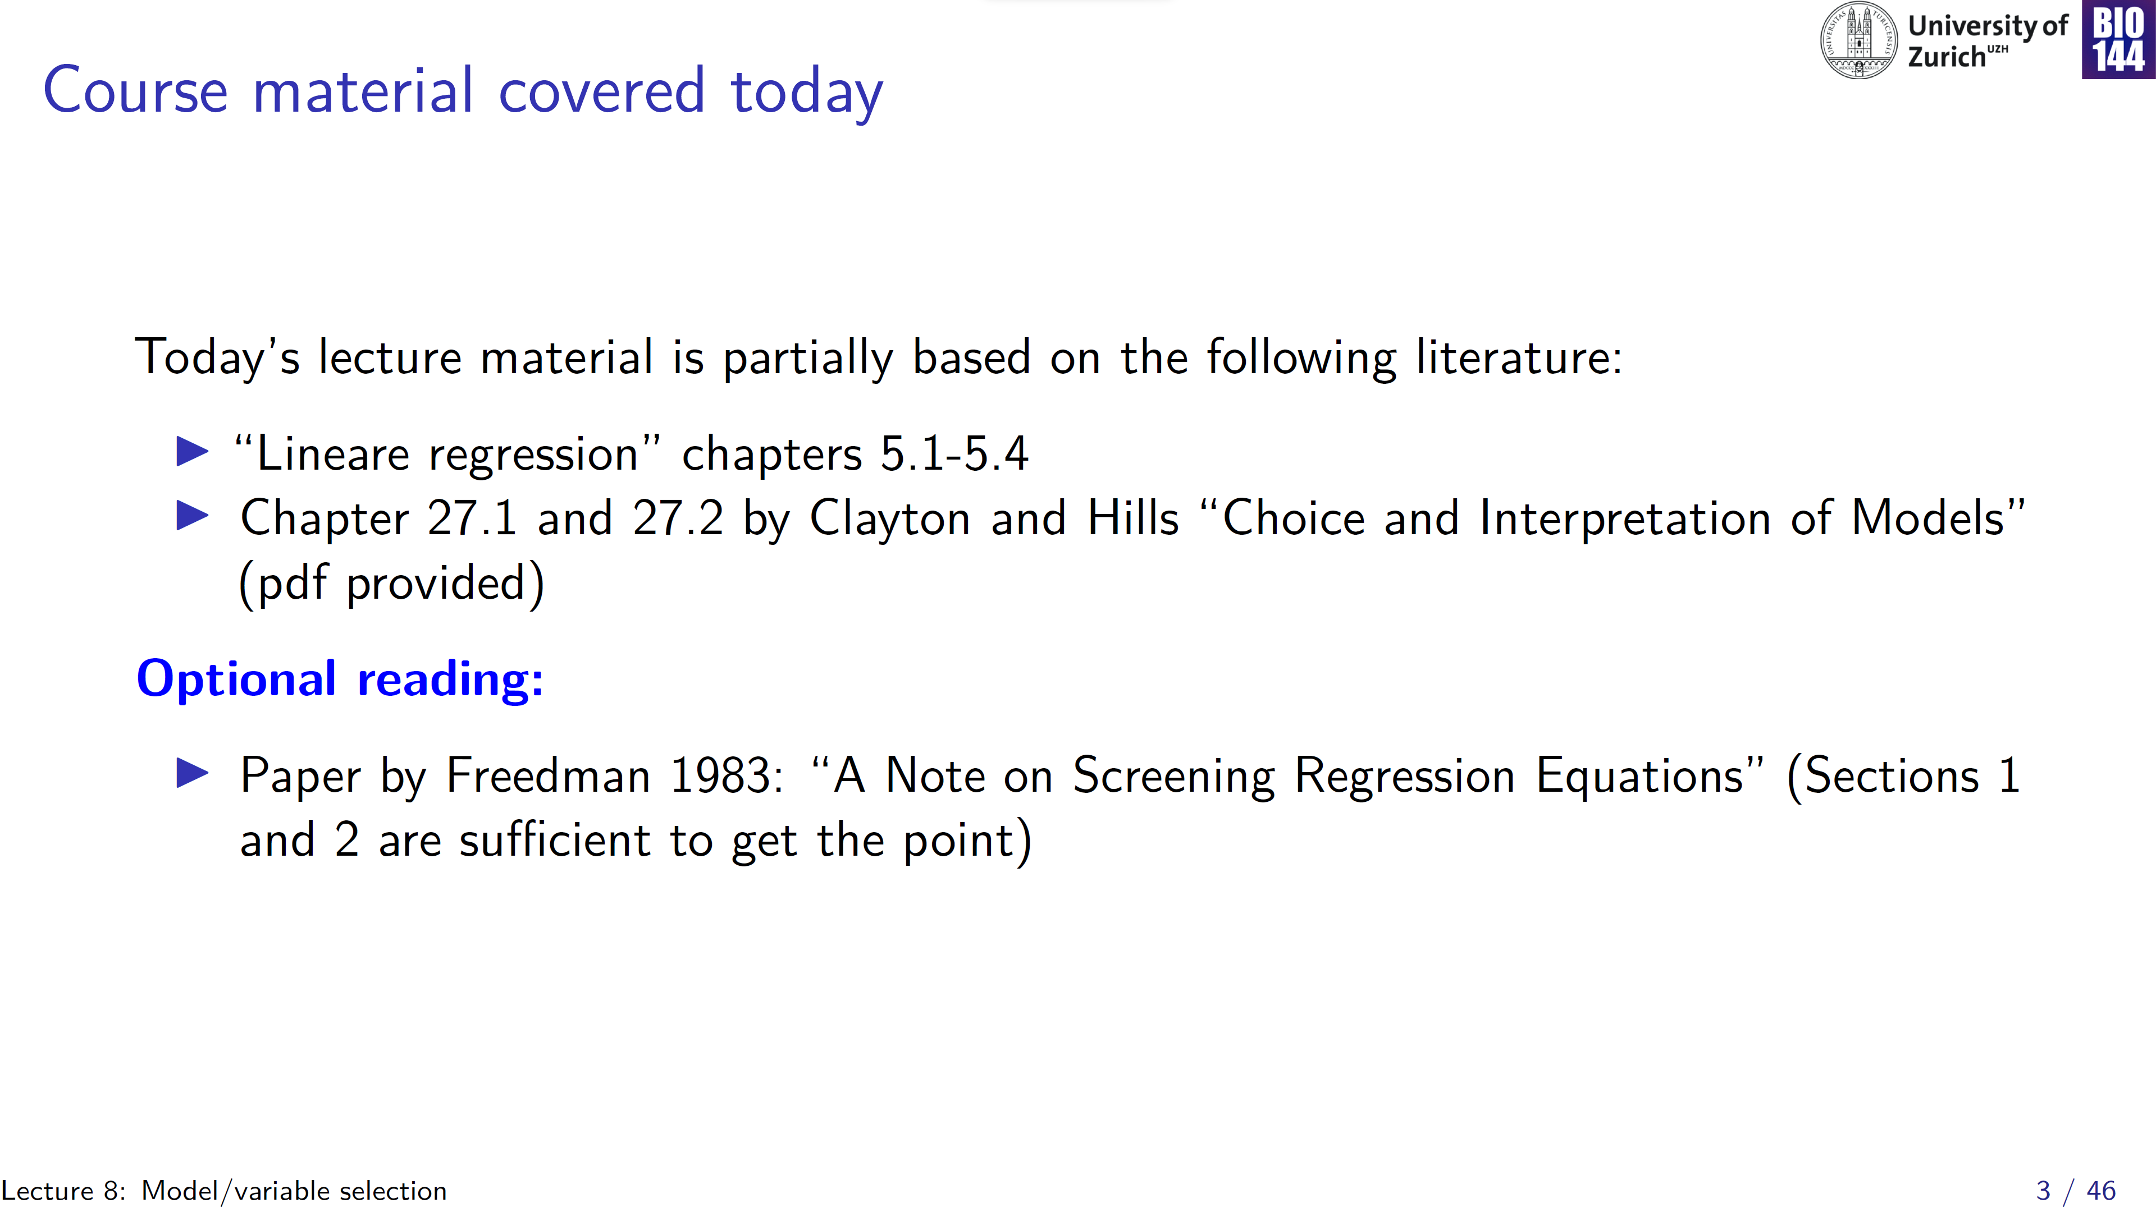

Slide 4
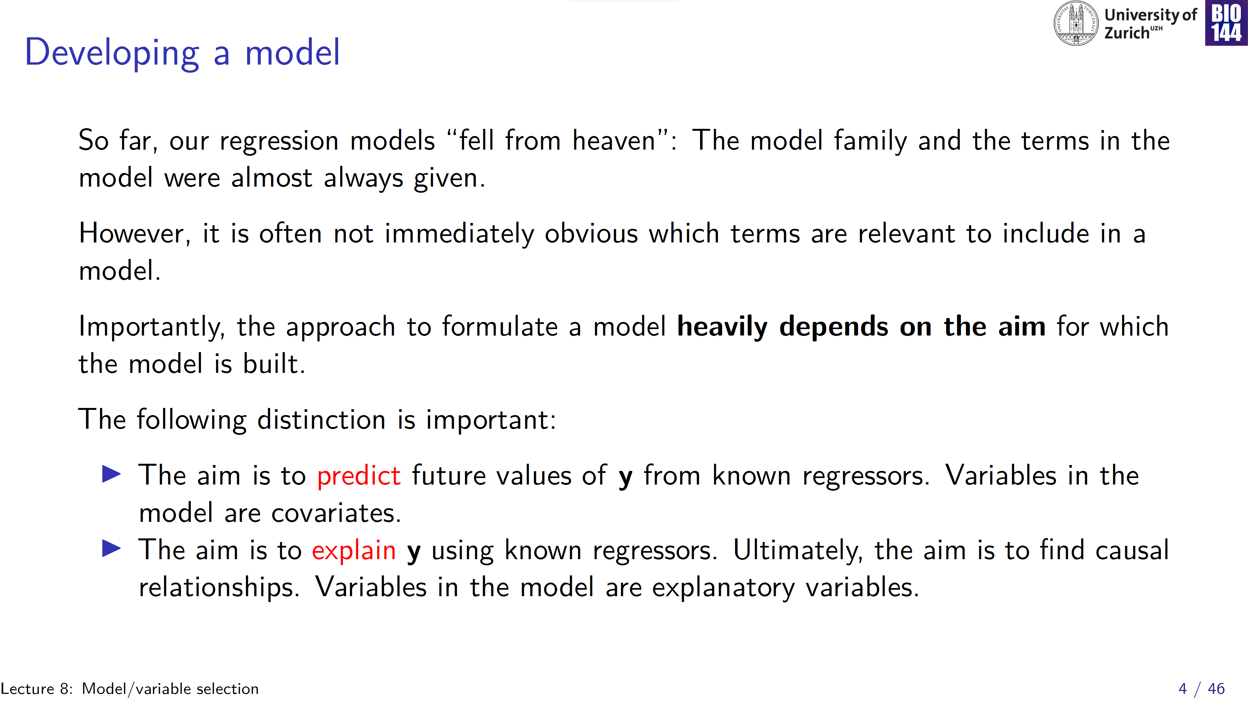

Slide 5
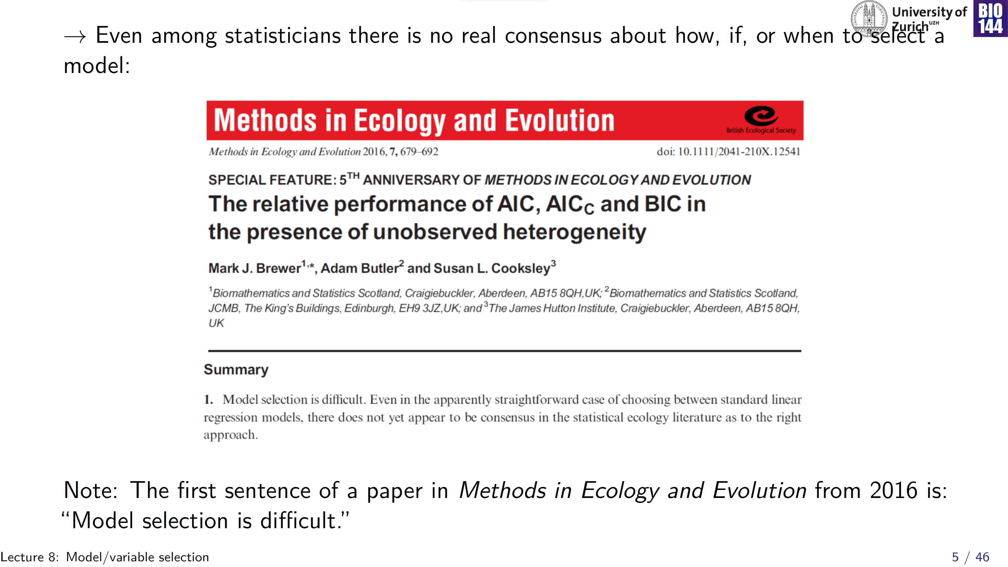

Slide 6
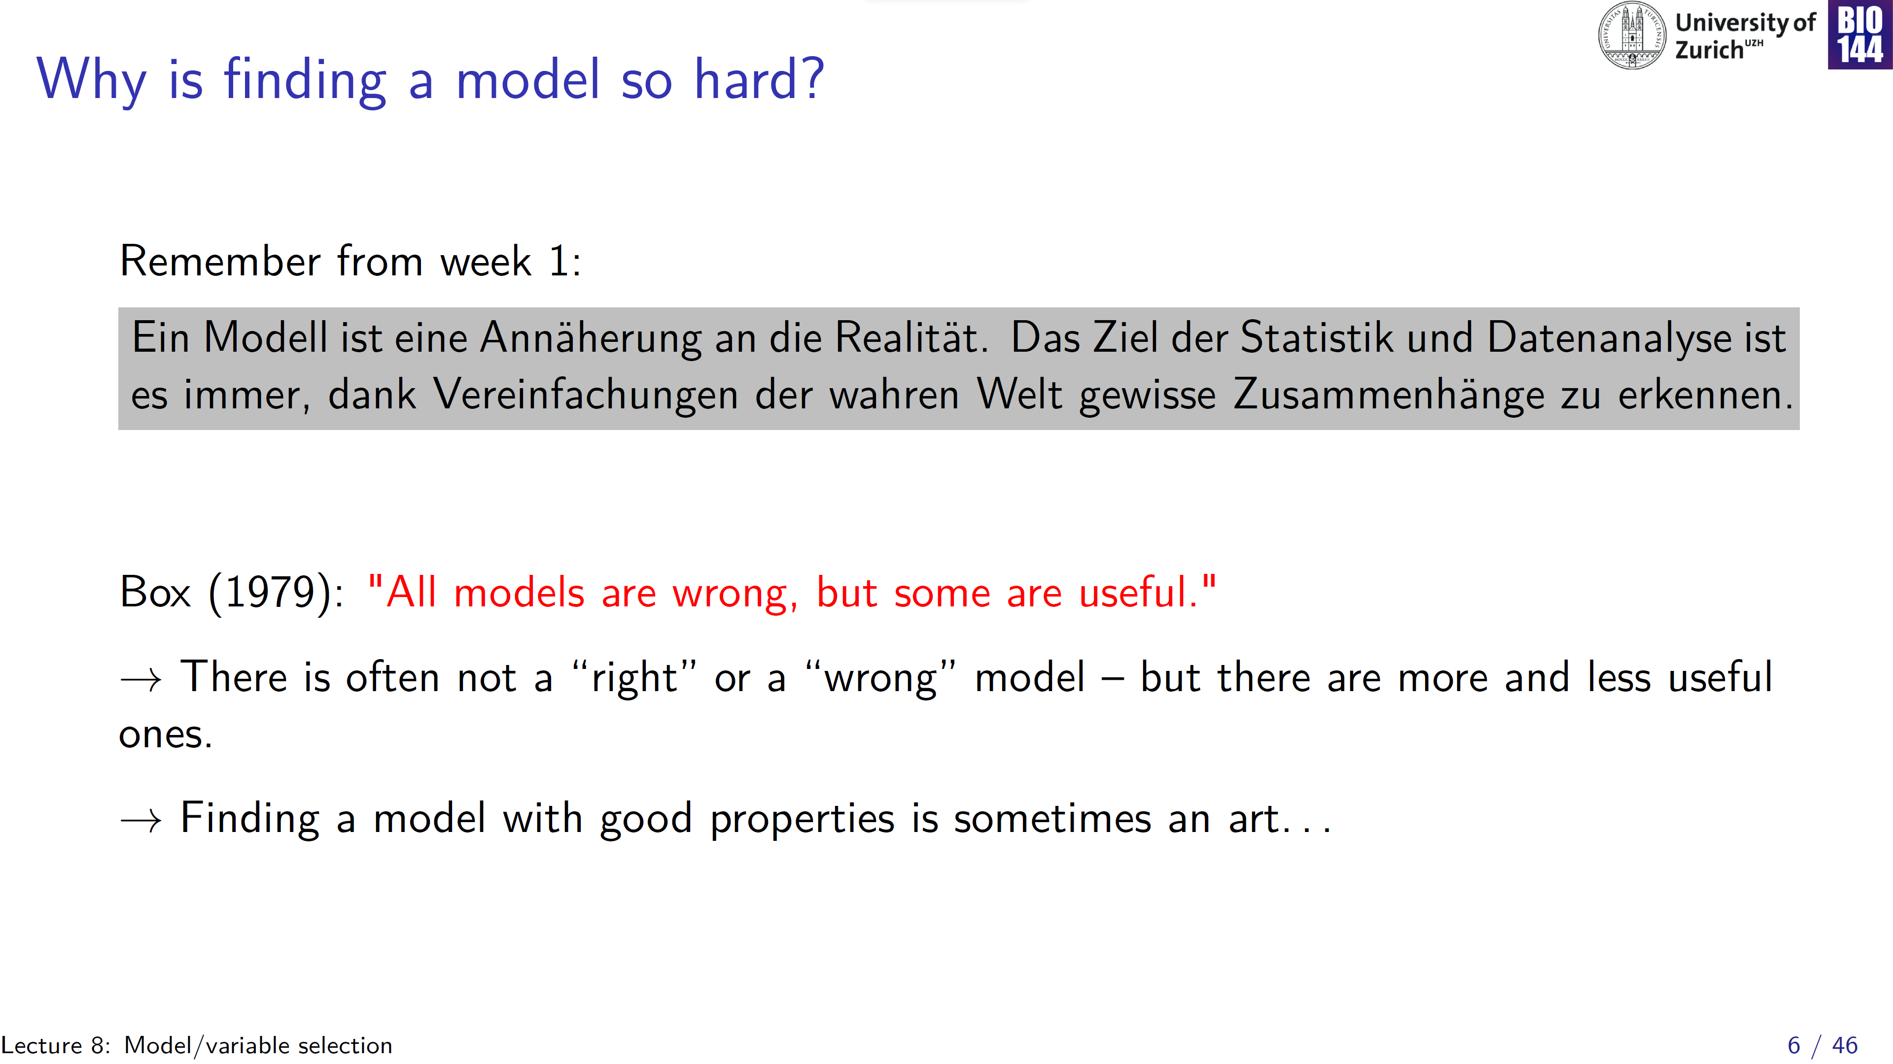

Slide 7
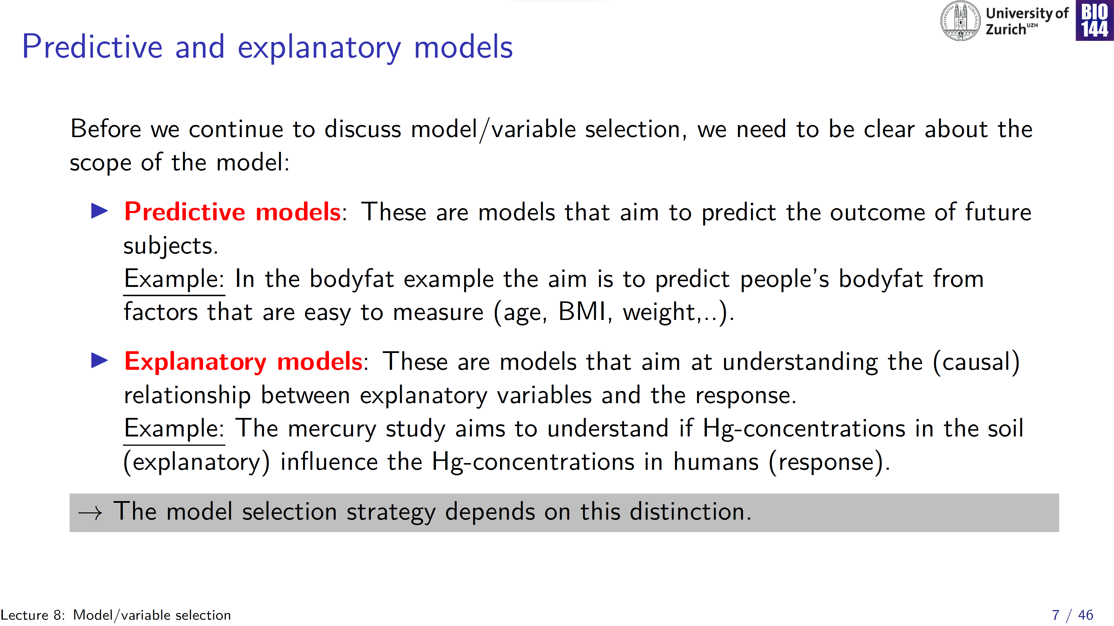

Slide 8
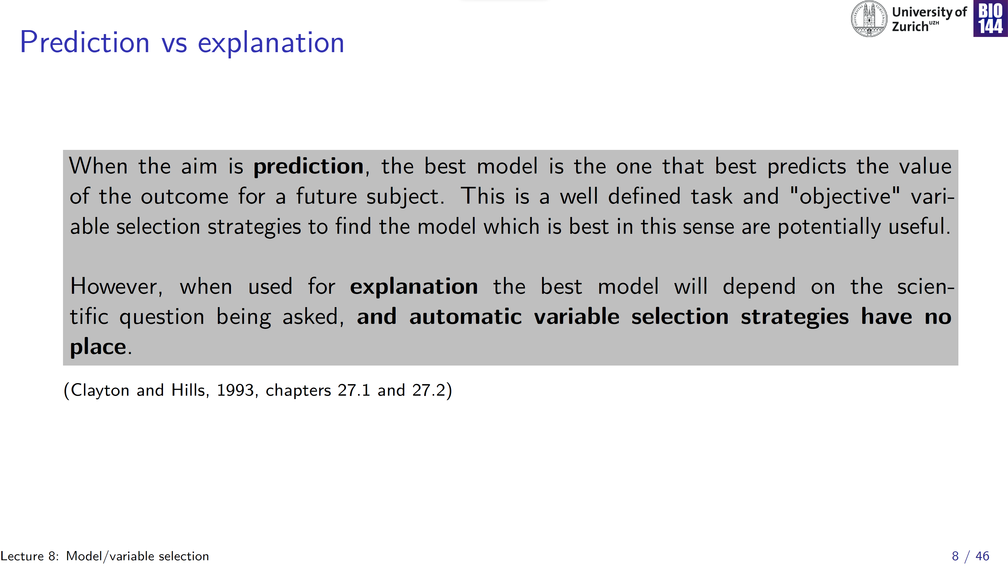
Use your “domain knowledge” (medical, biological, … ) instead!

Slide 9
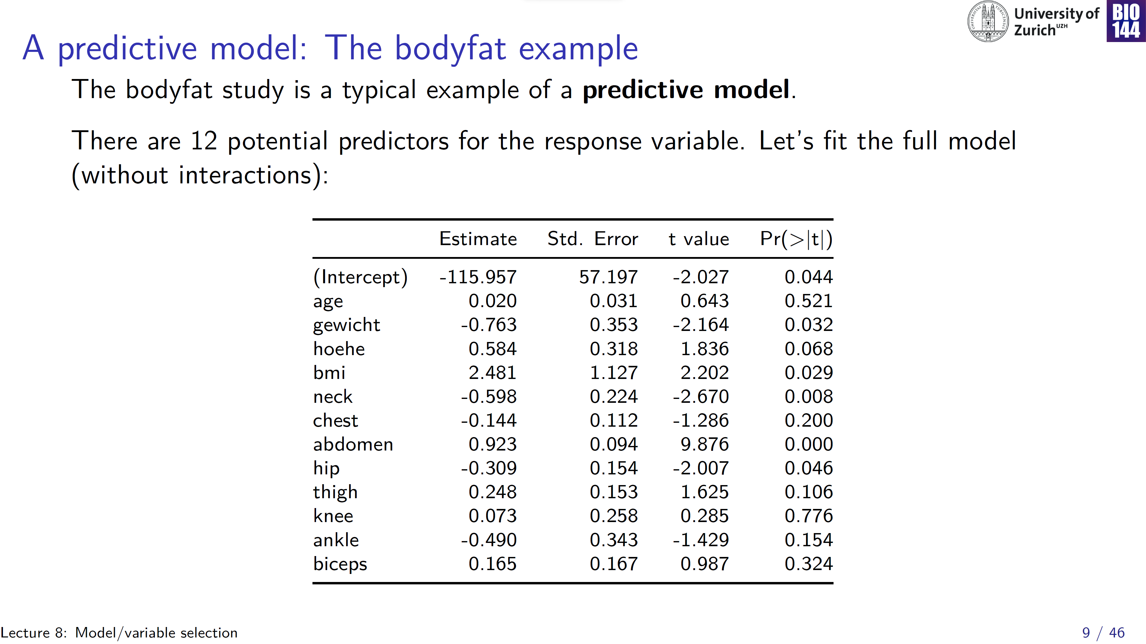
Don’t interpret!
Caricature of approach:
“throw them all in”
Let the data speak for themselves
→ the (eventual) model is a blackbox: prediction without understanding

Slide 10
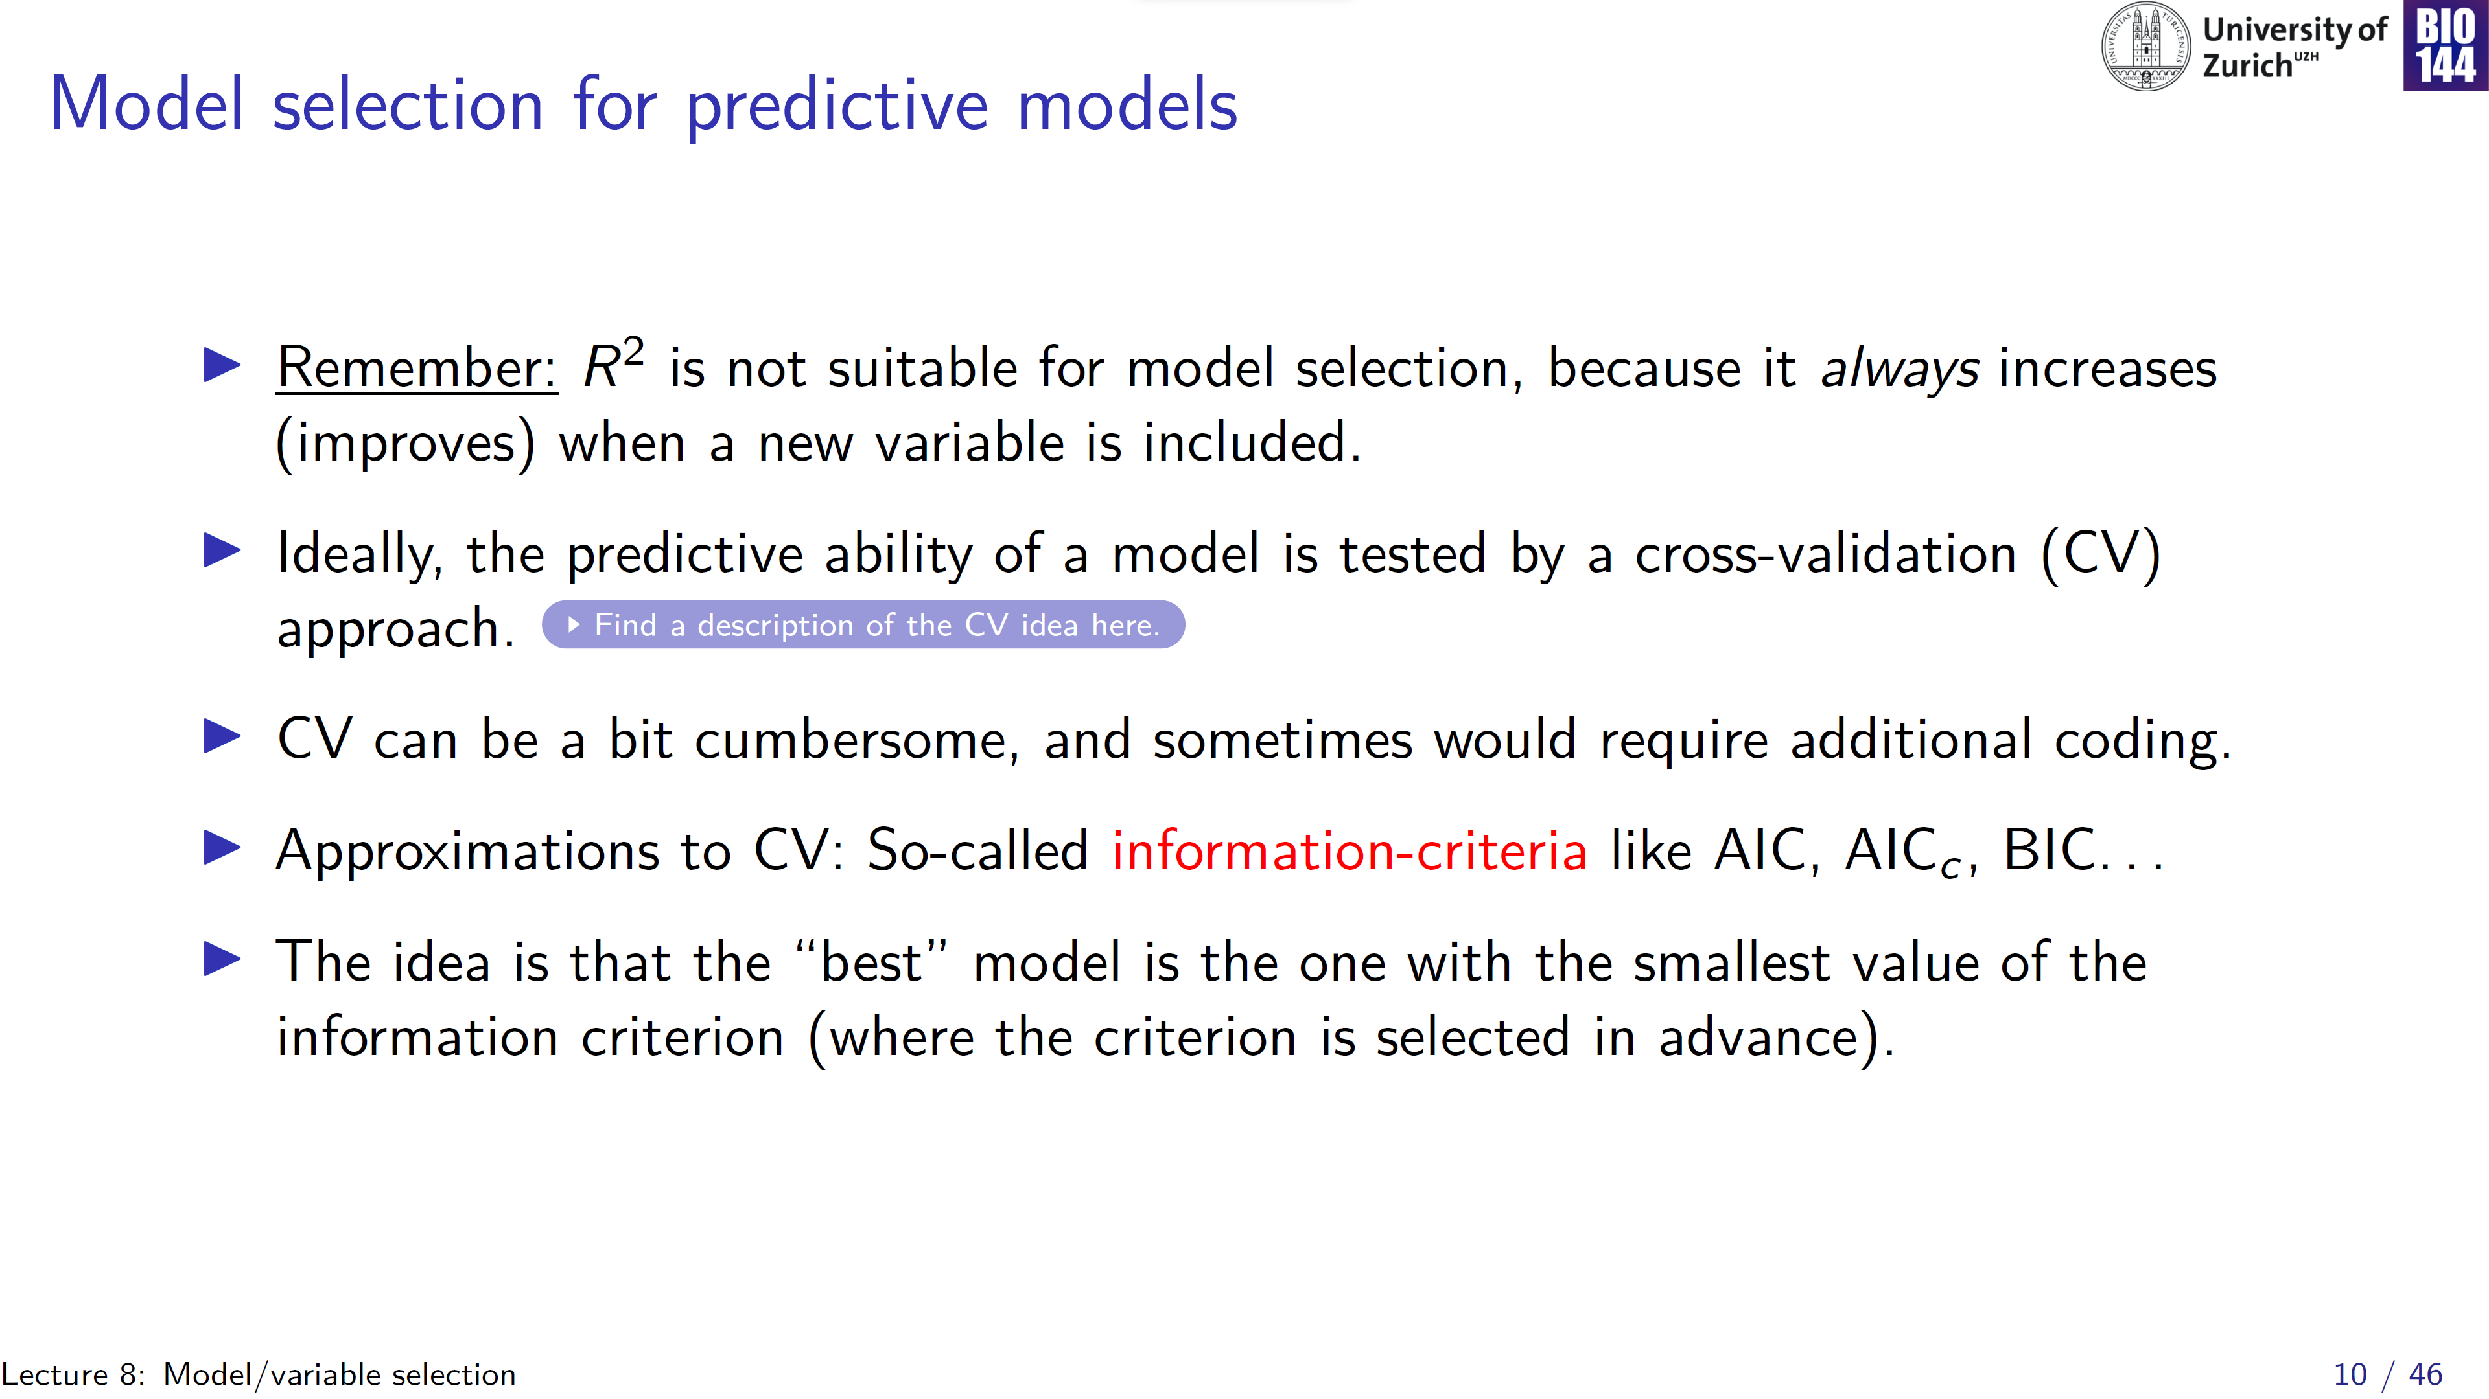
Notes:
CV: split data into a training dataset and a test dataset -> requires a large number of observations

Slide 11
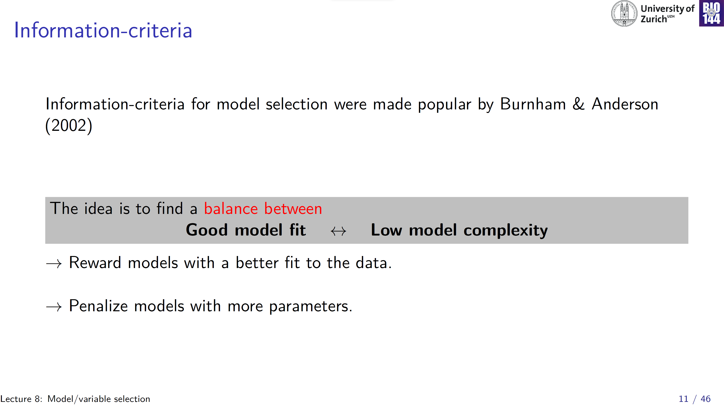

Slide 12
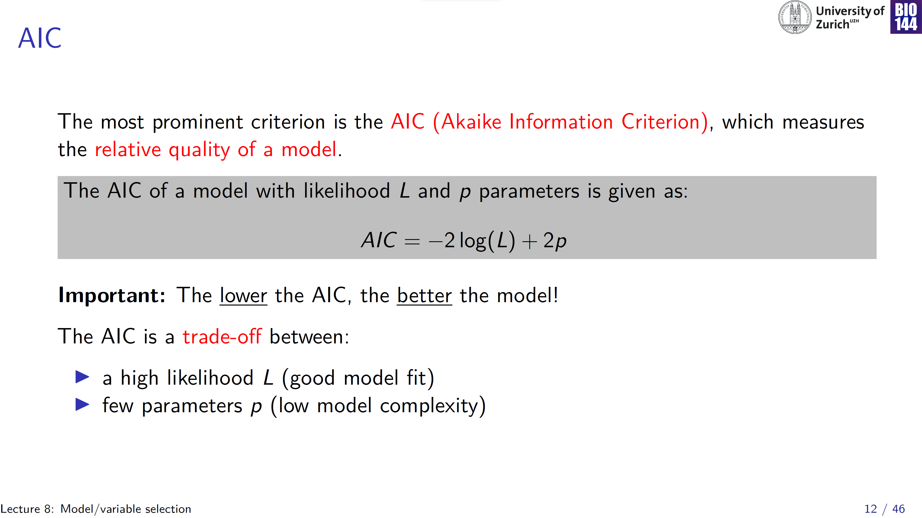

Slide 13
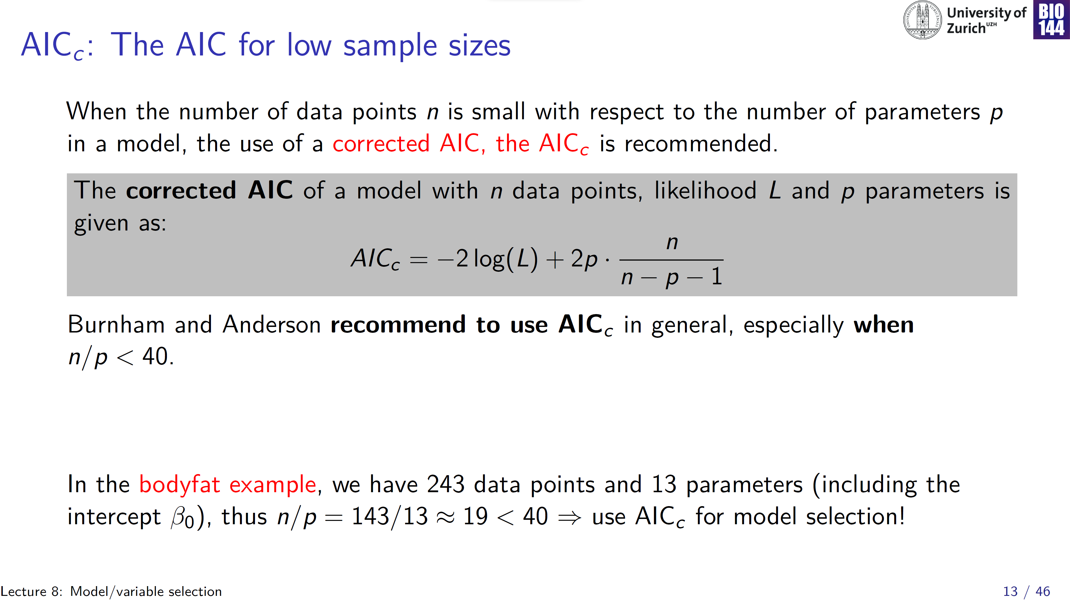
Penalty term is higher than in the normal AIC, especially for smaller sample sizes

Slide 14
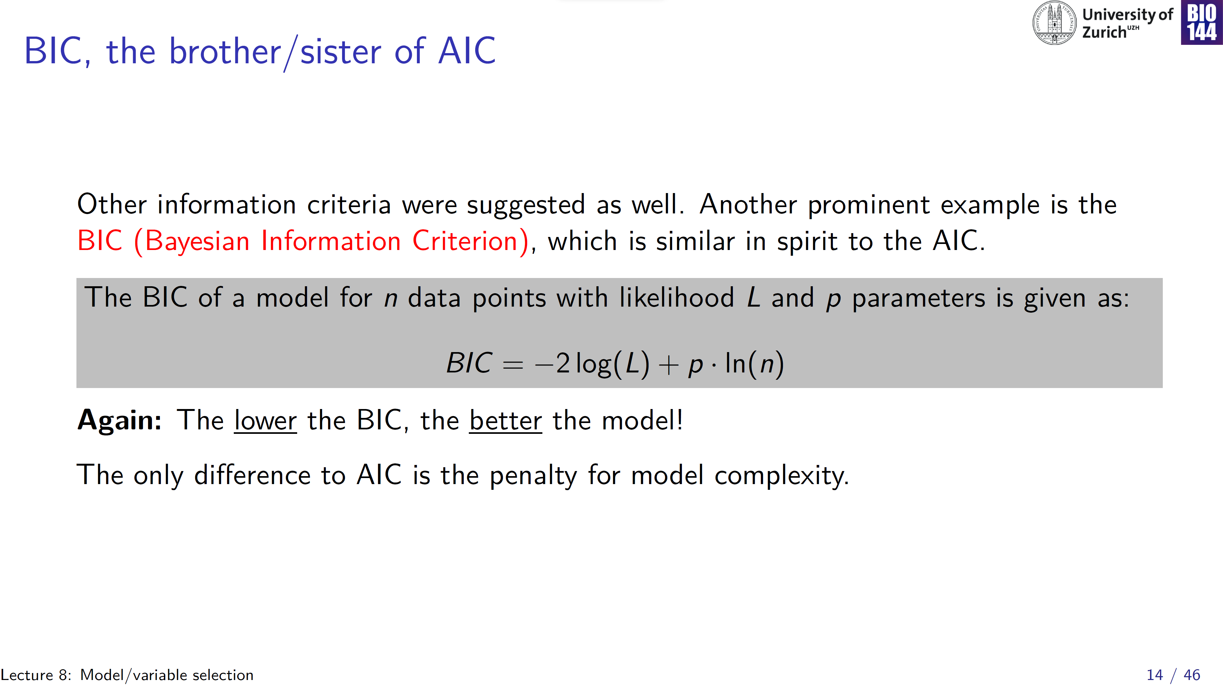

Slide 15
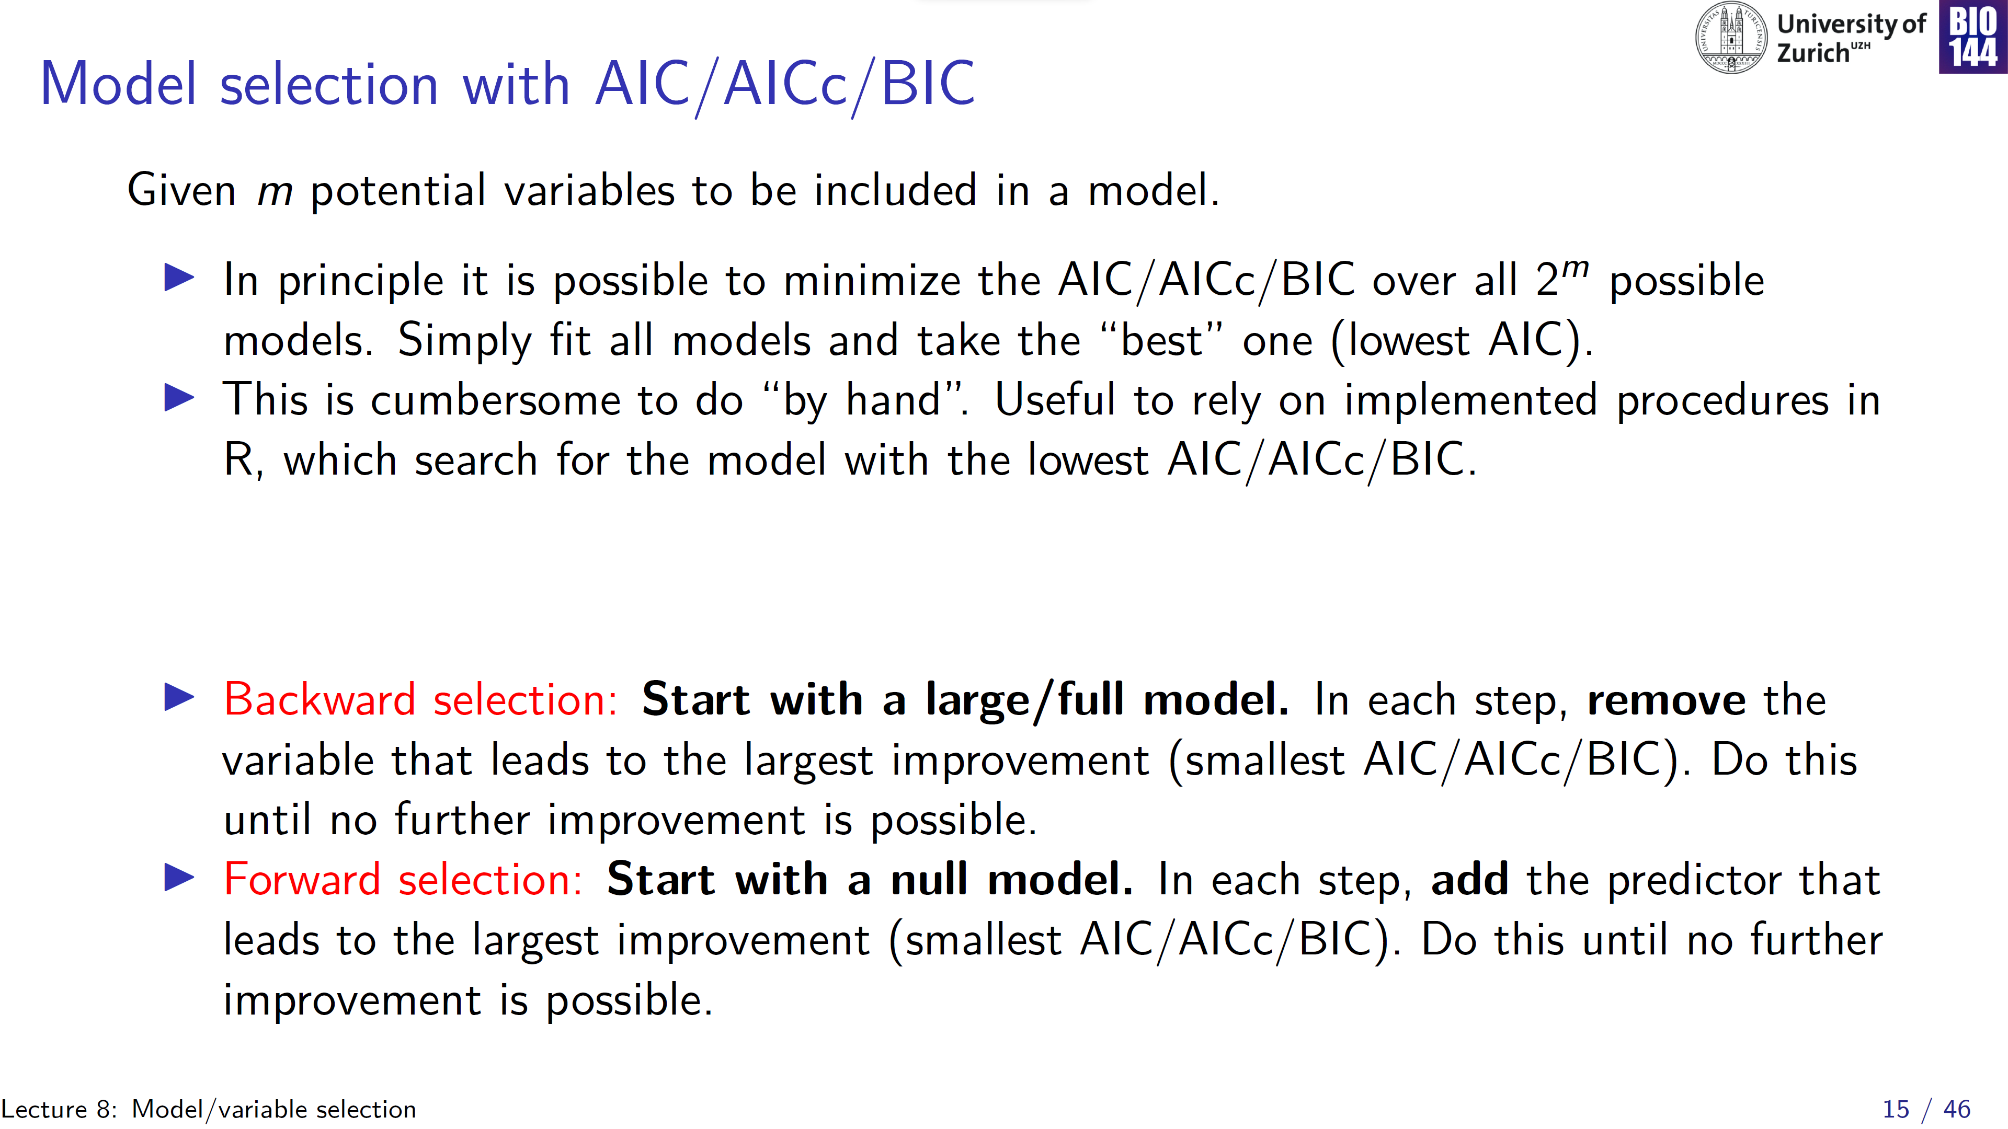

Slide 16
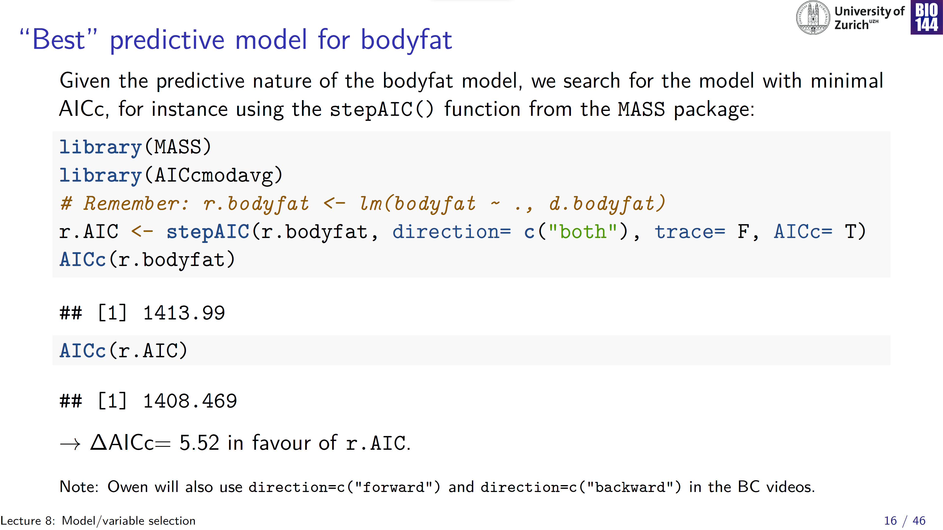
Information criteria express relative performance:
Absolute value has no real interpretation
Only compare models fitted to the same data (always check sample size!)
Notes:
In isolation the values of information criteria are not-informative!

Slide 17
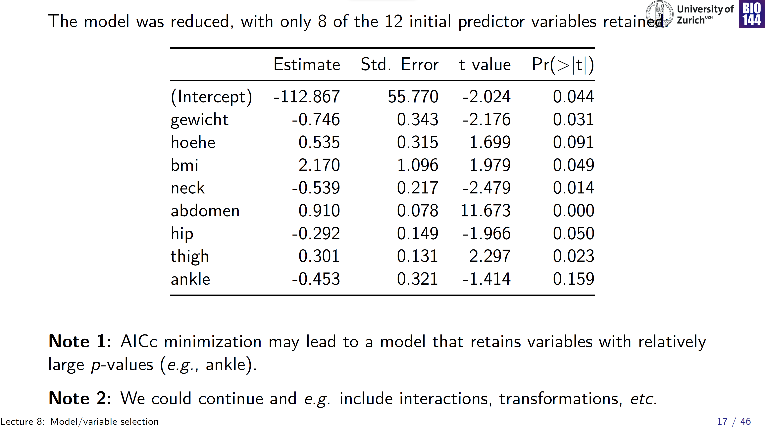
Don’t interpret!

Slide 18
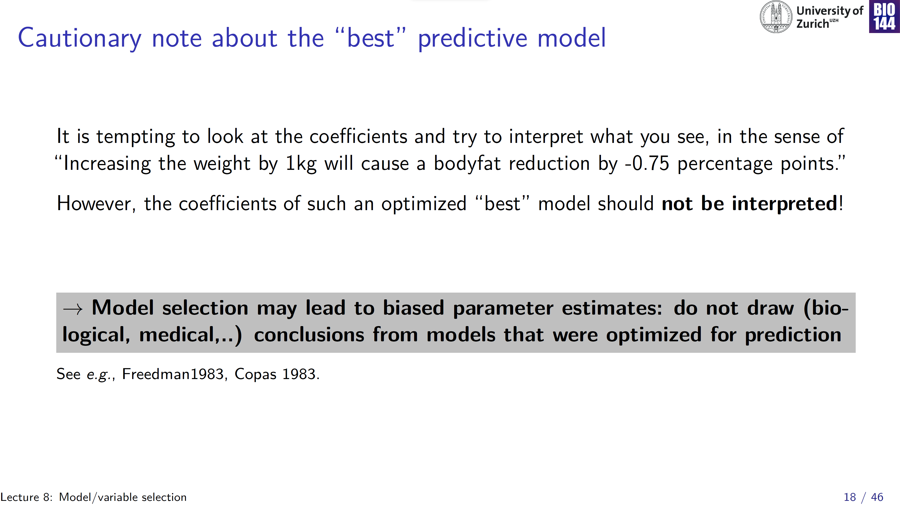
Really think of prediction optimised models as a blackbox: prediction without understanding

Slide 19
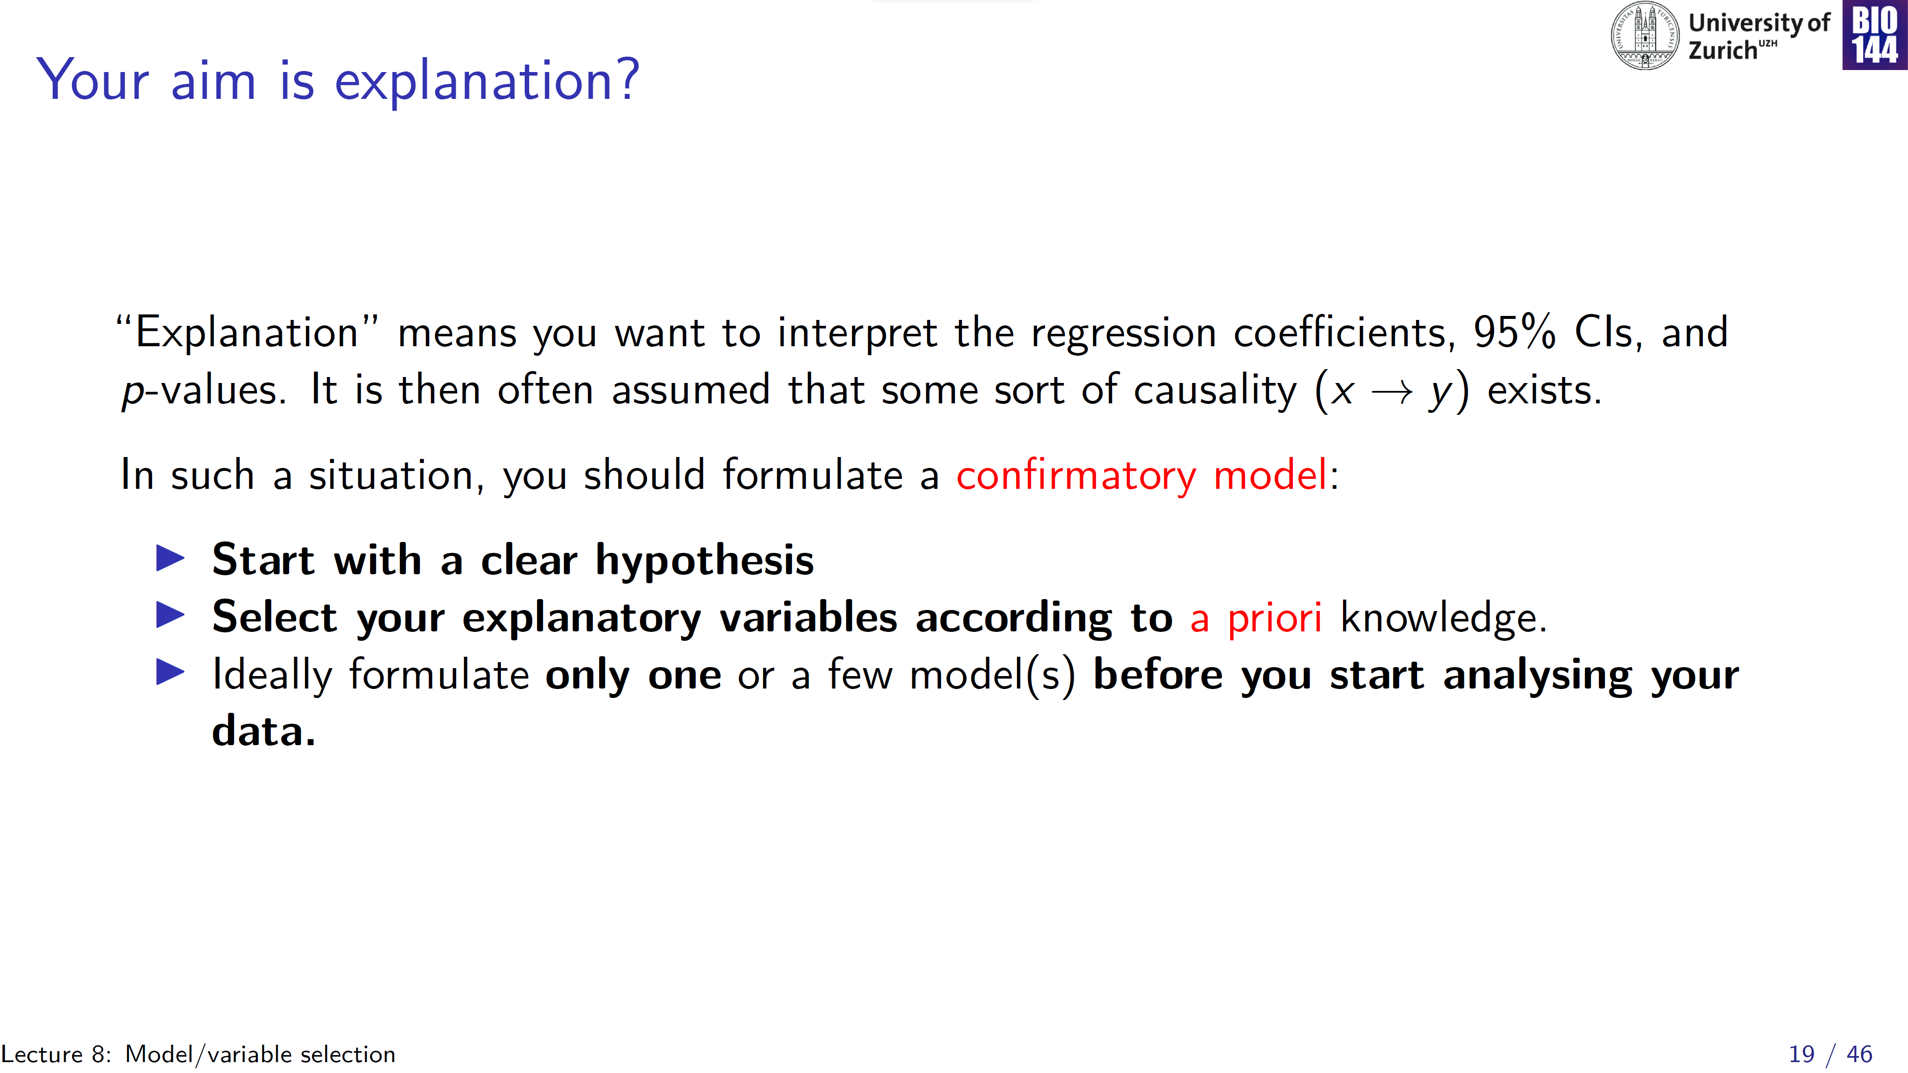

Slide 20
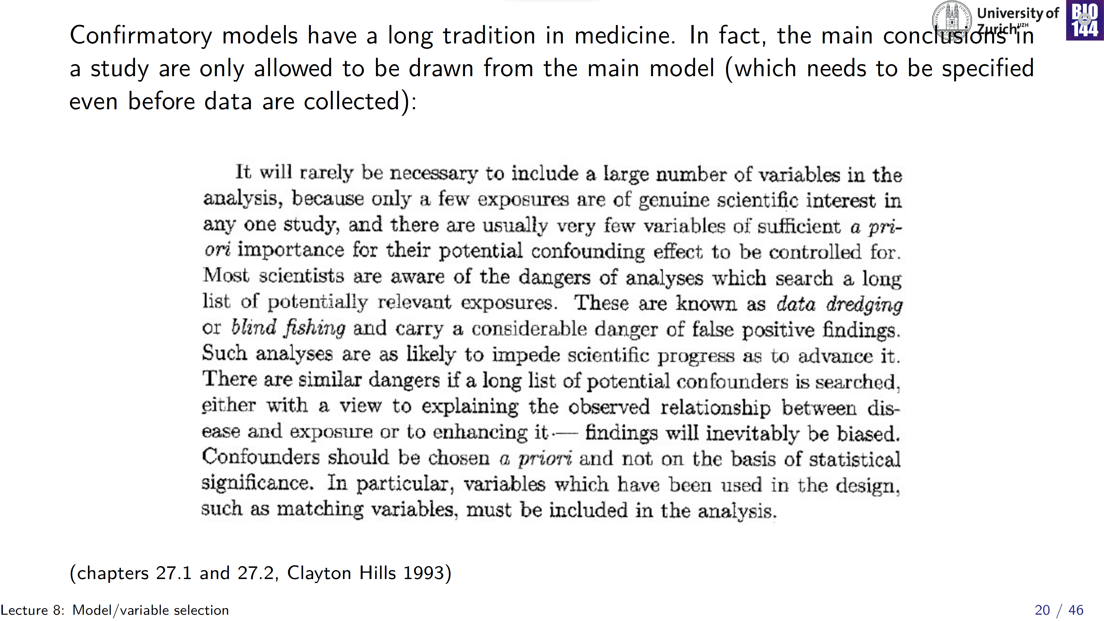
Notes:
You have access to this on OLAT

Slide 21
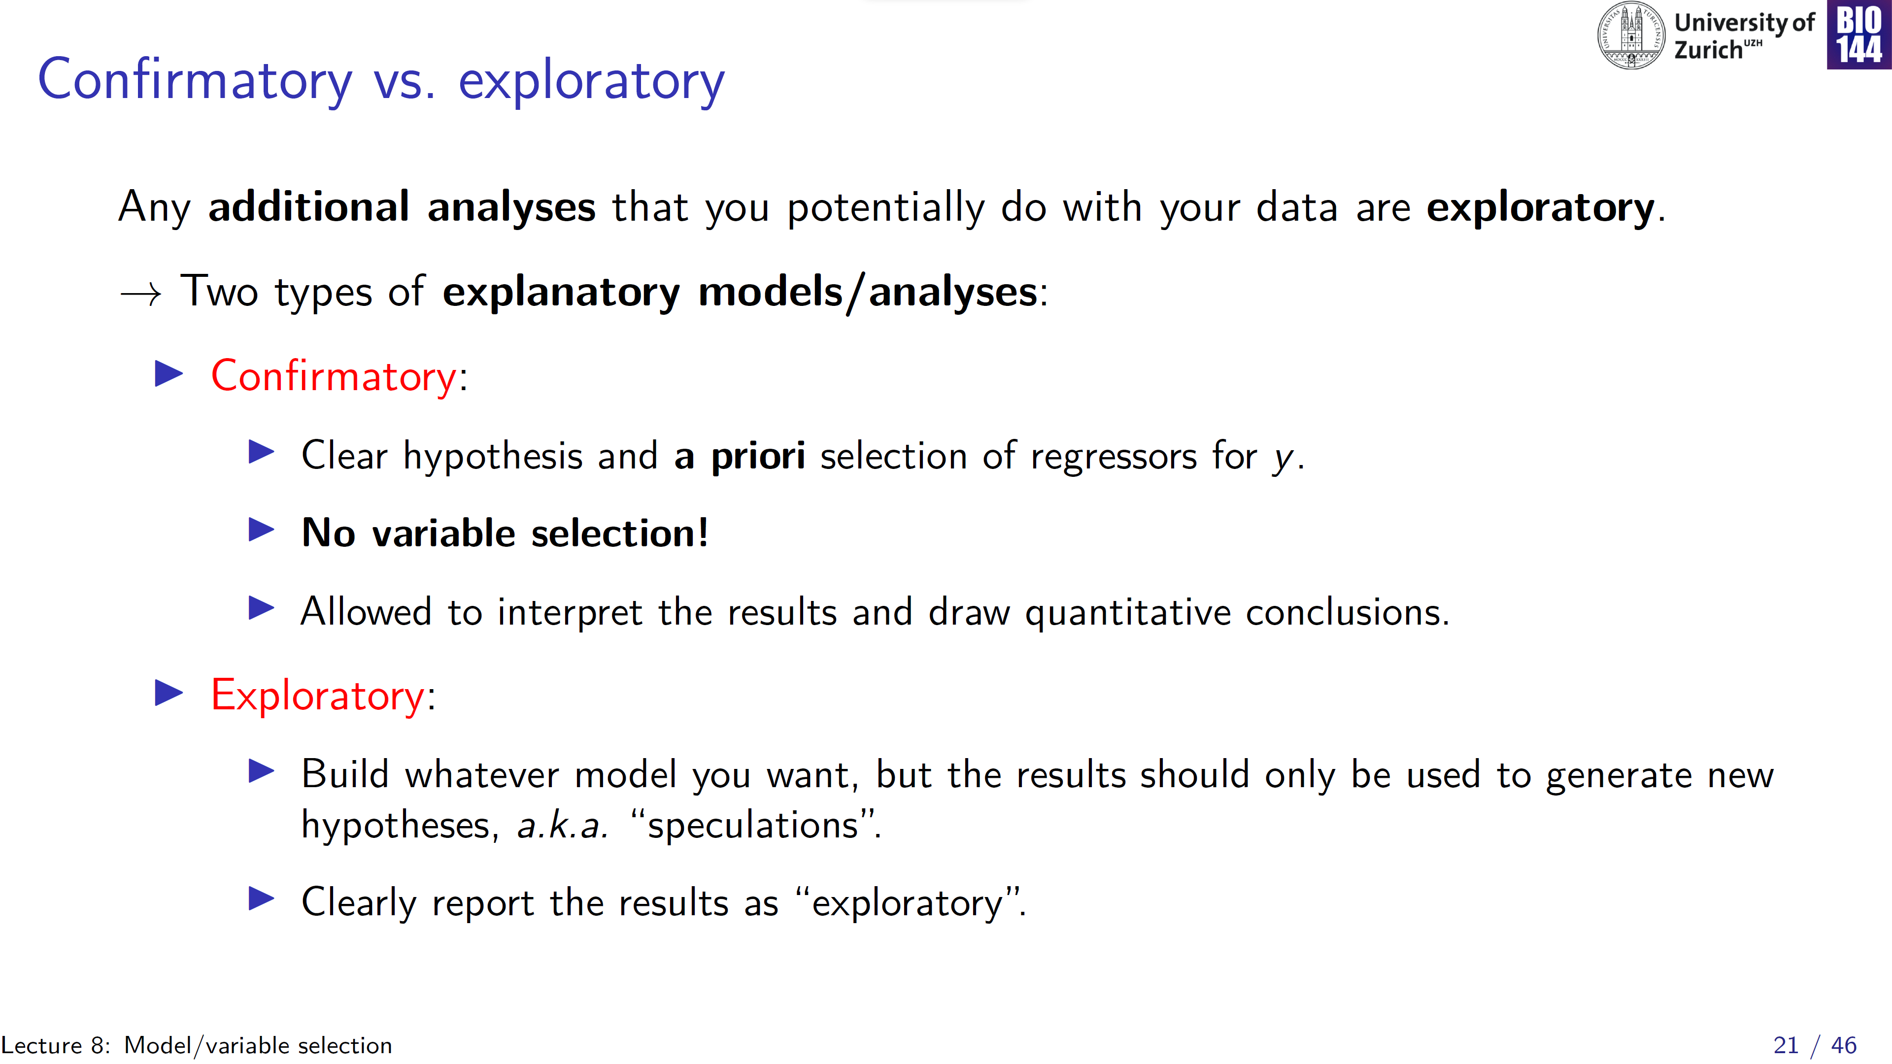

Slide 22
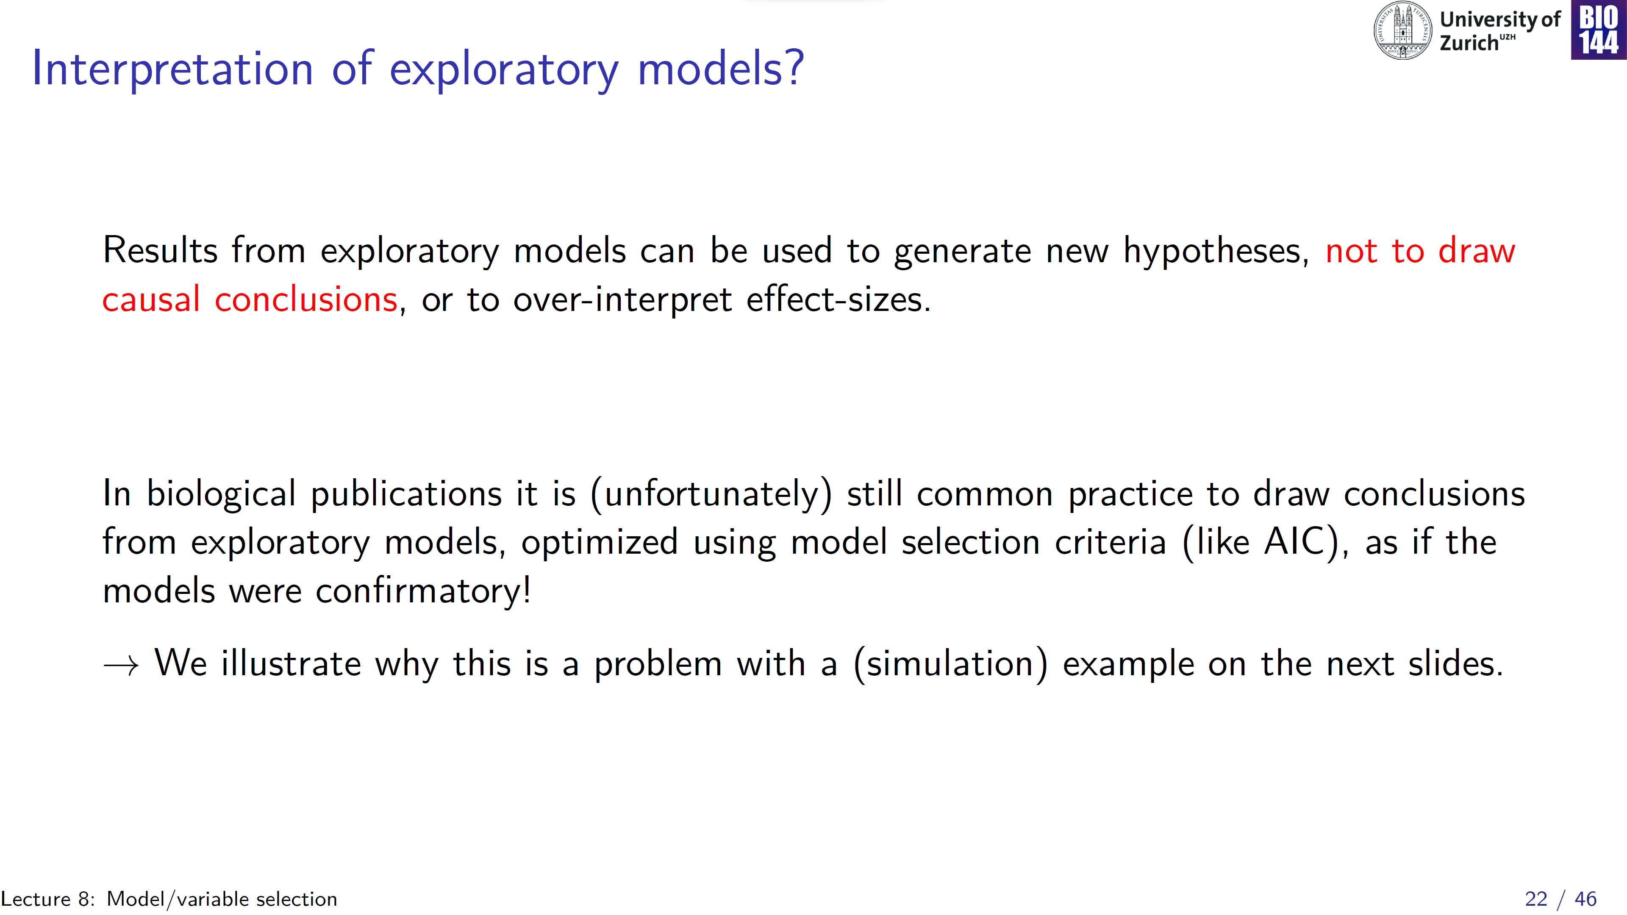
Notes:
Had break following this slide!

Slide 23
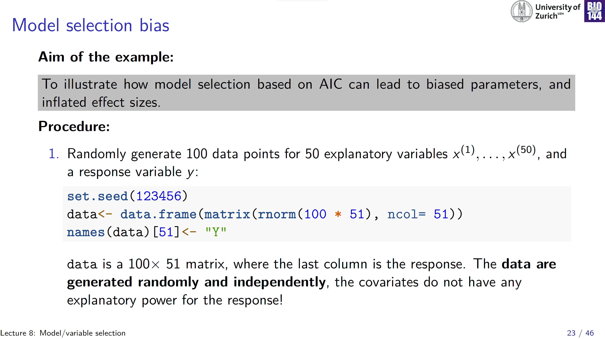
Notes:
Remember, we talked about matrices two weeks ago!

Slide 24
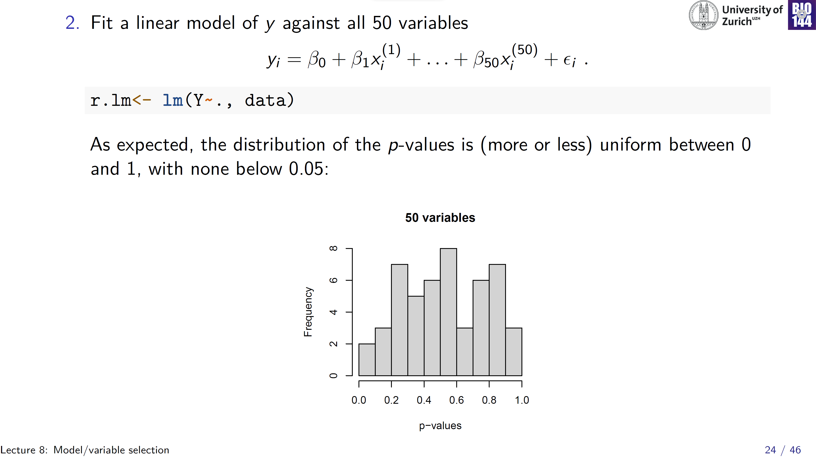

Slide 25
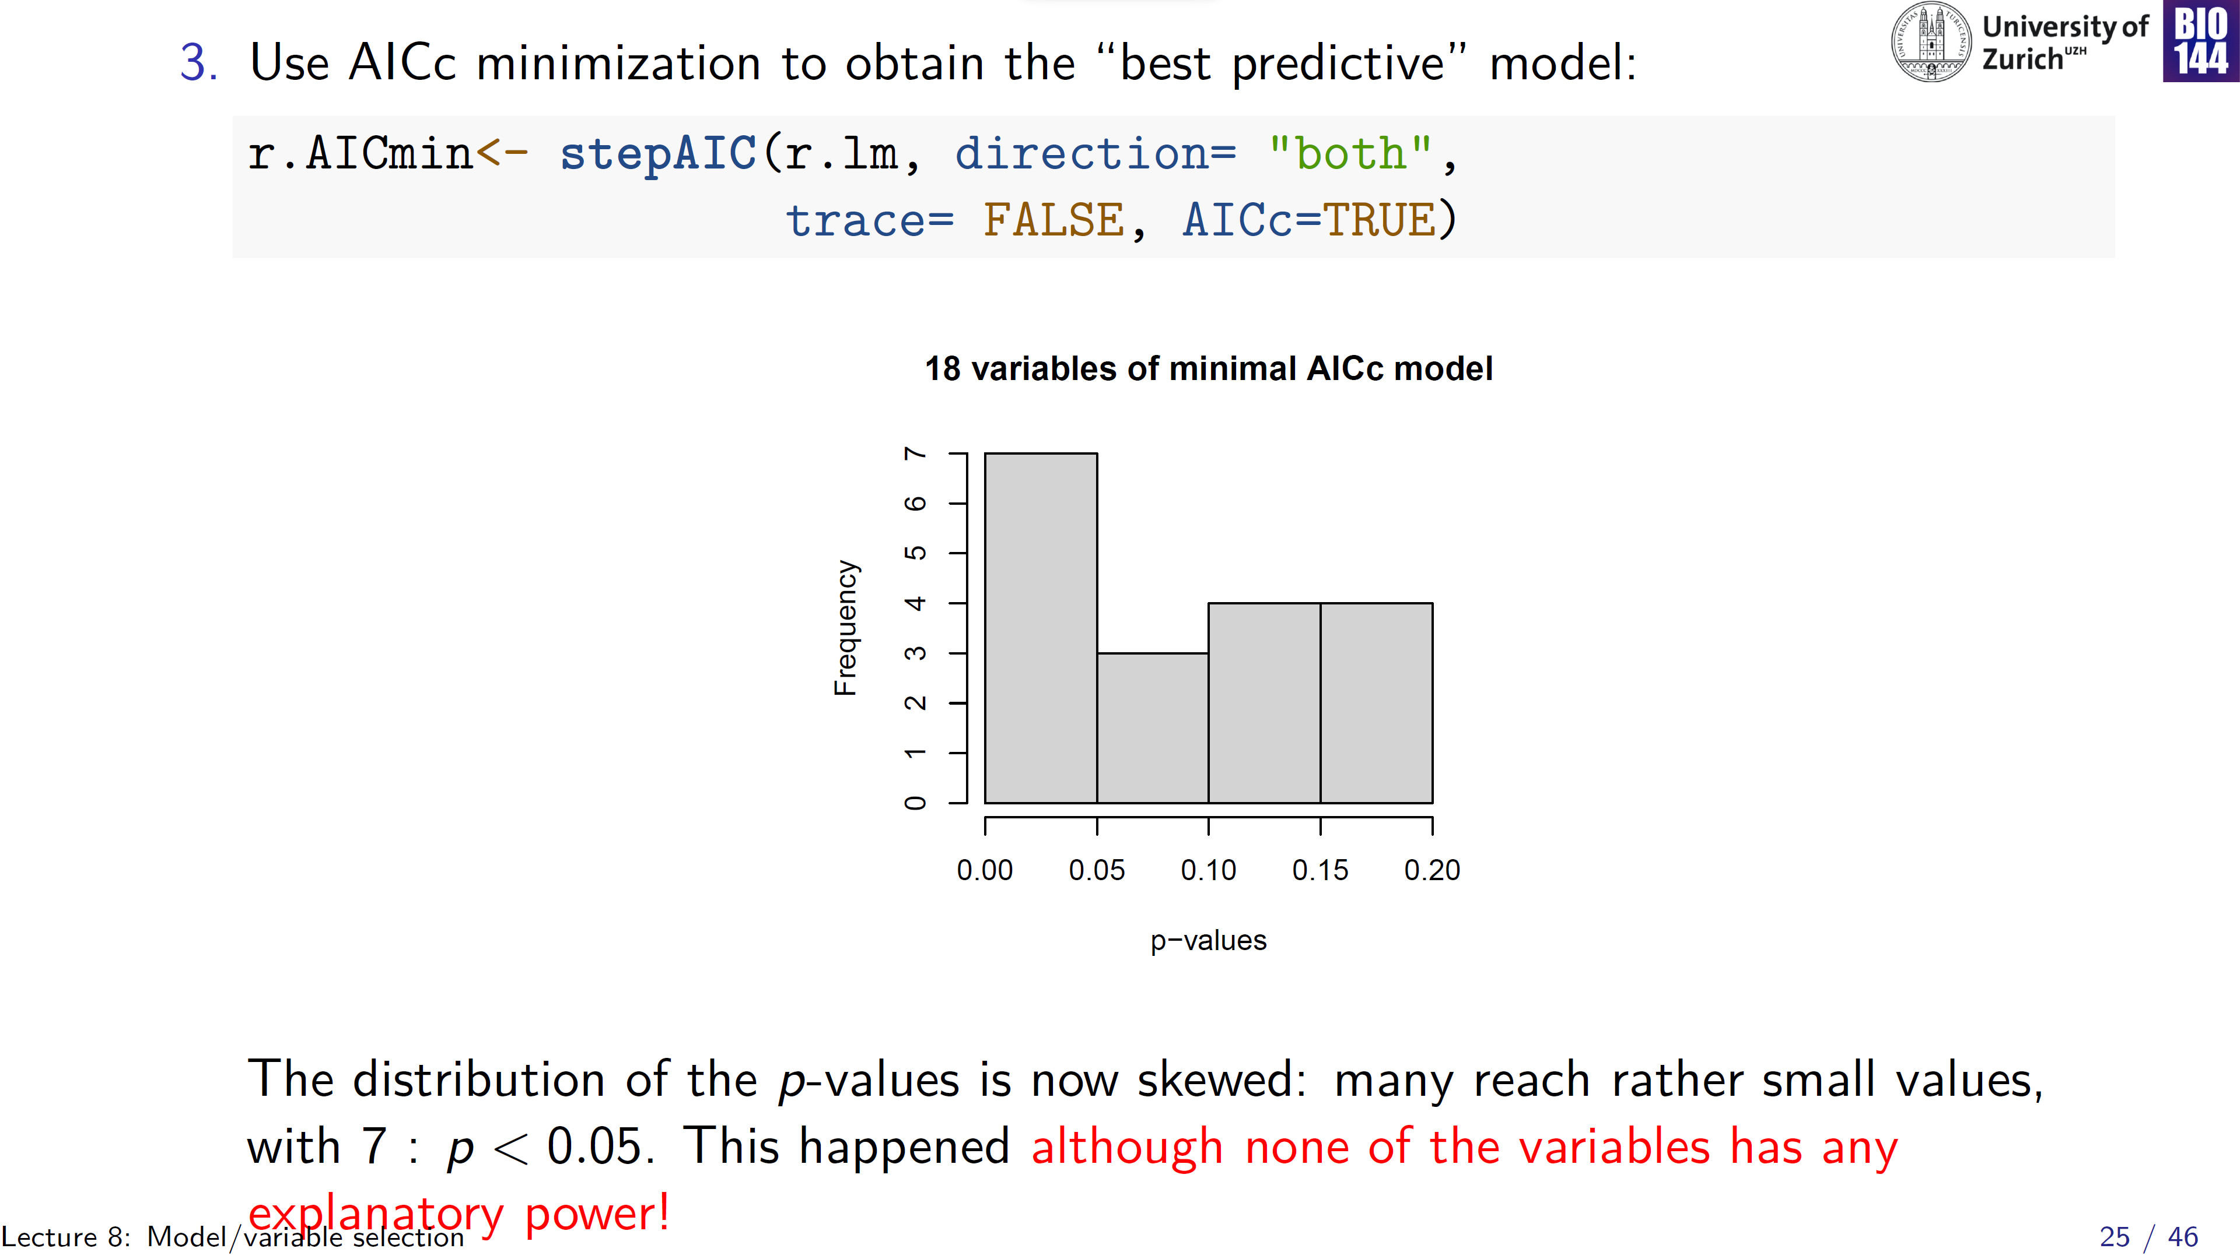
1.0
Notes:
Model is reduced to contain 18 out of the original 50 covariates

Slide 26
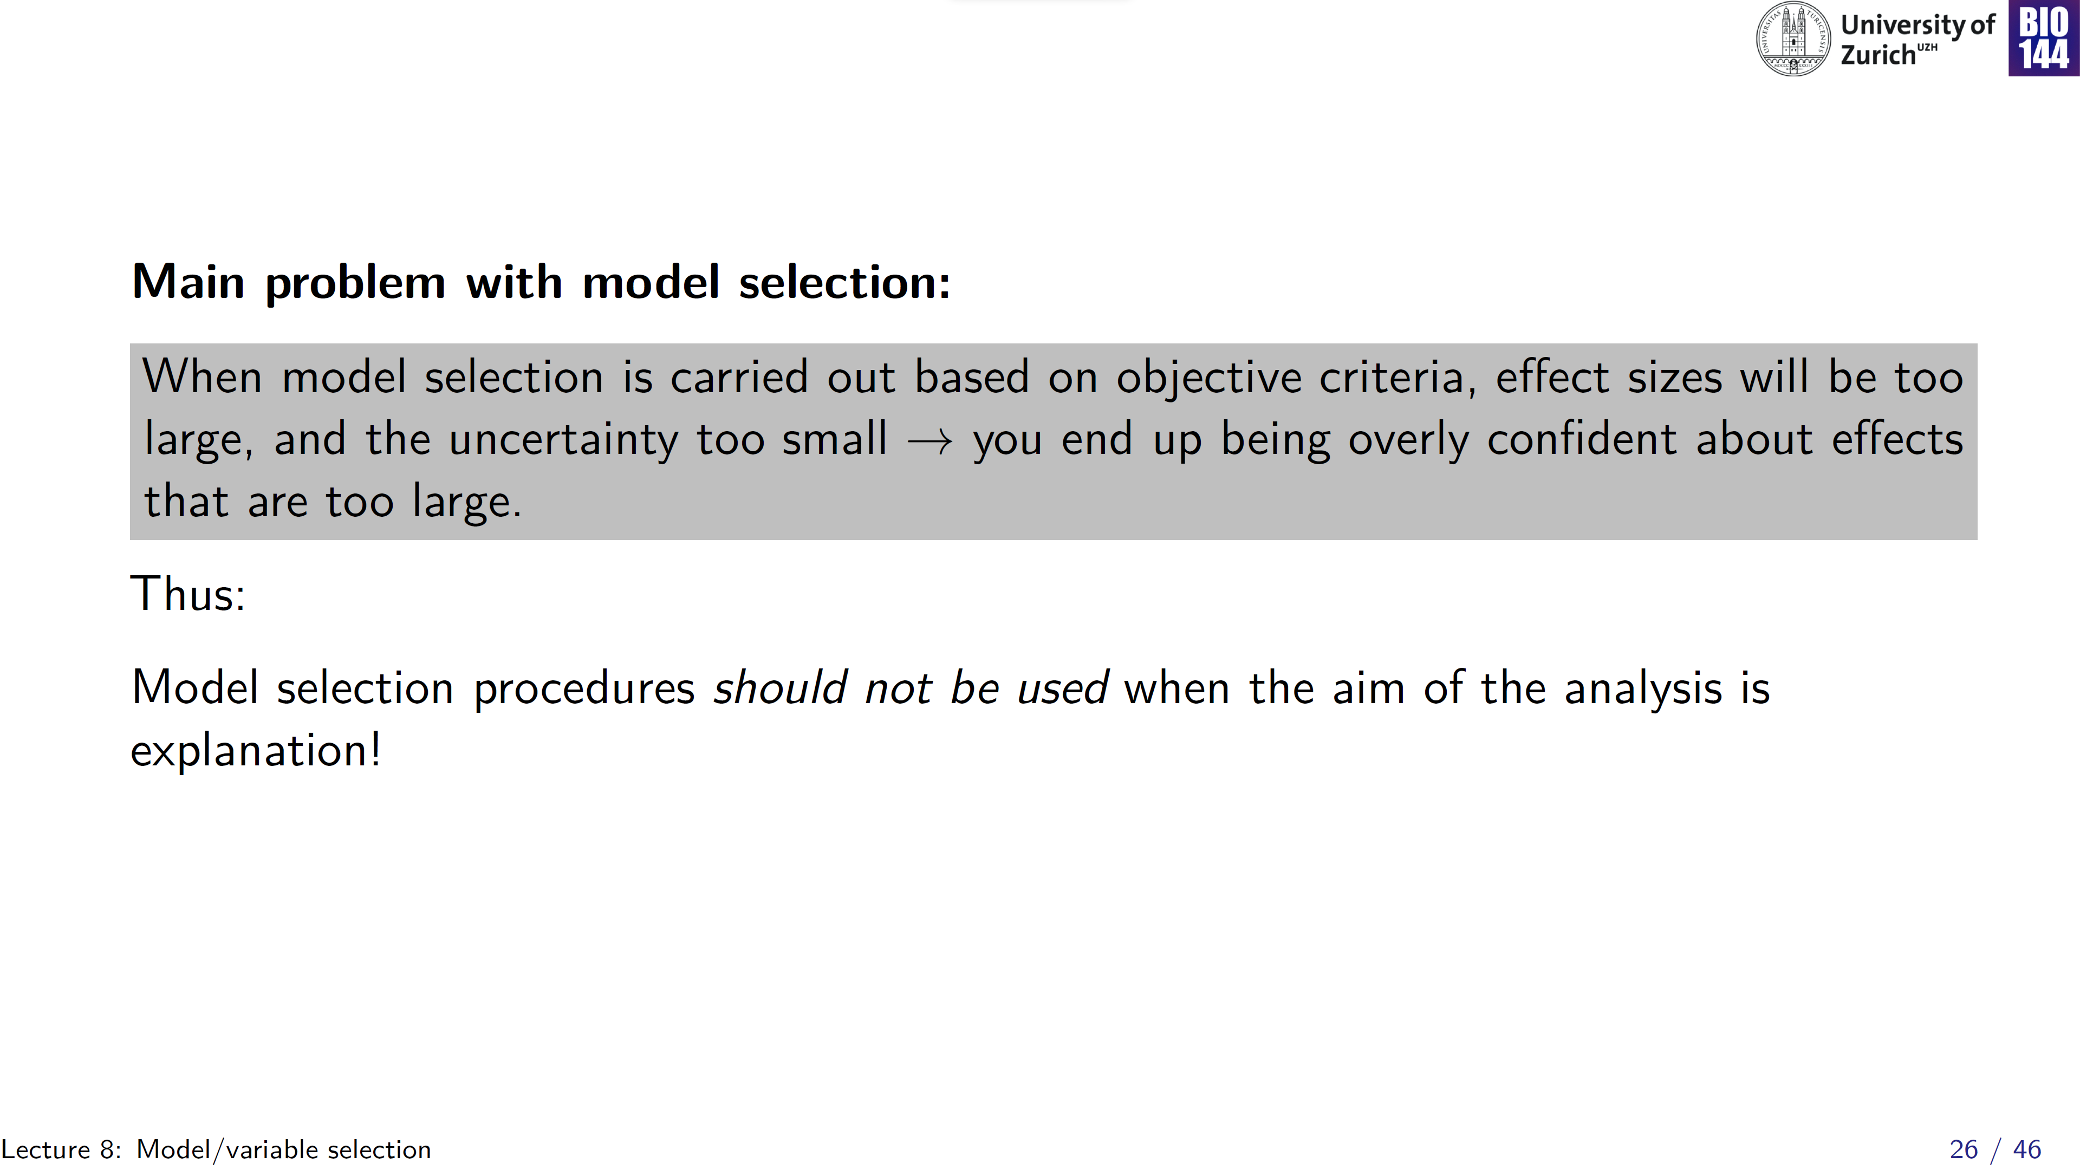
Type I errors (i.e. “false positives”)

Slide 27
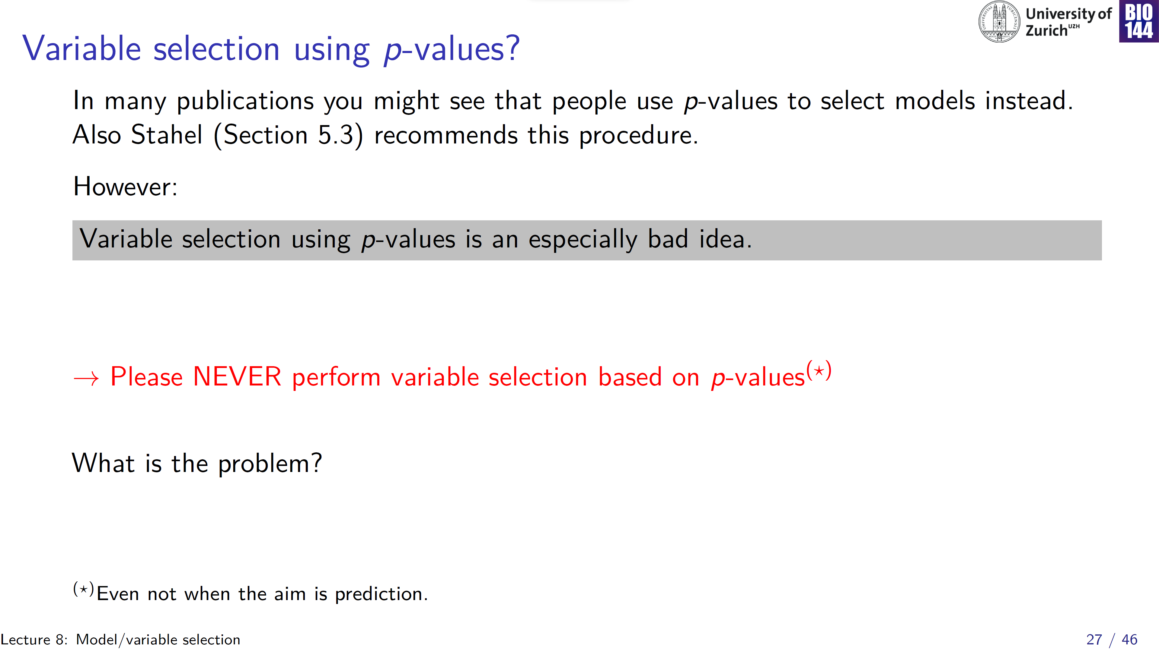

Slide 28
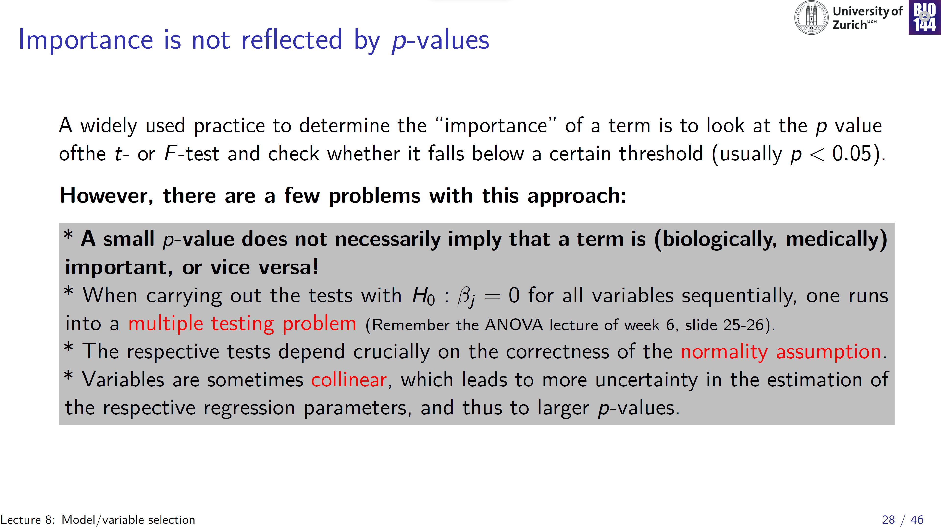
Notes:
P-values are largely driven by sample size: a large sample size, as e.g. in genomic studies will even indicate that variables with a very small, biologically non-interesting effect, are statistically significant!
Multiple testing, again inflated Type I error rate
Normality
Collinearity -> can lead to erratic p-values

Slide 29
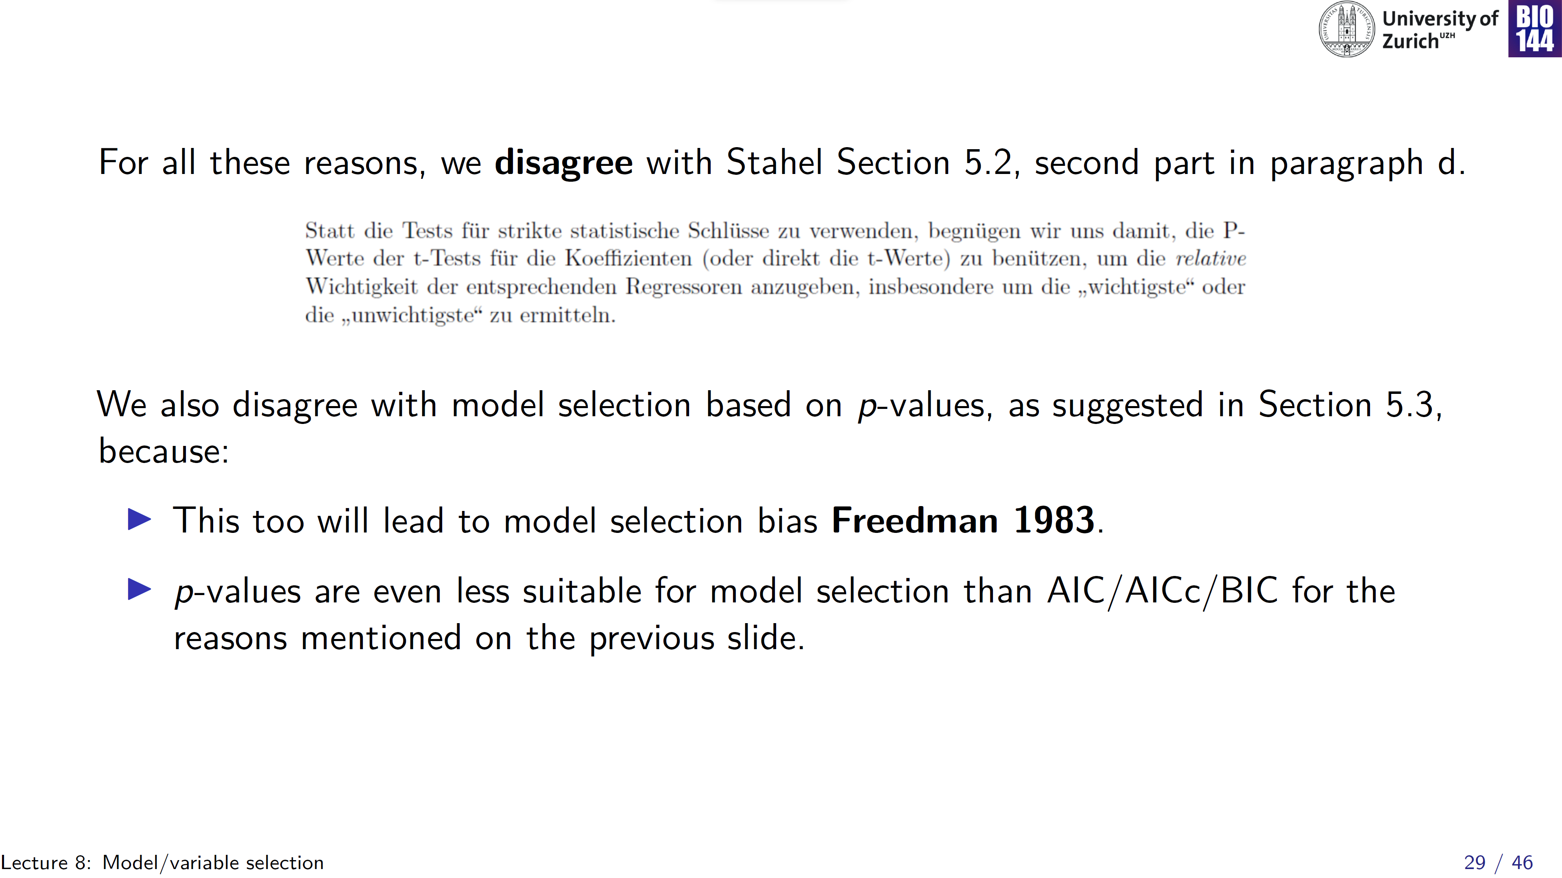

Slide 30
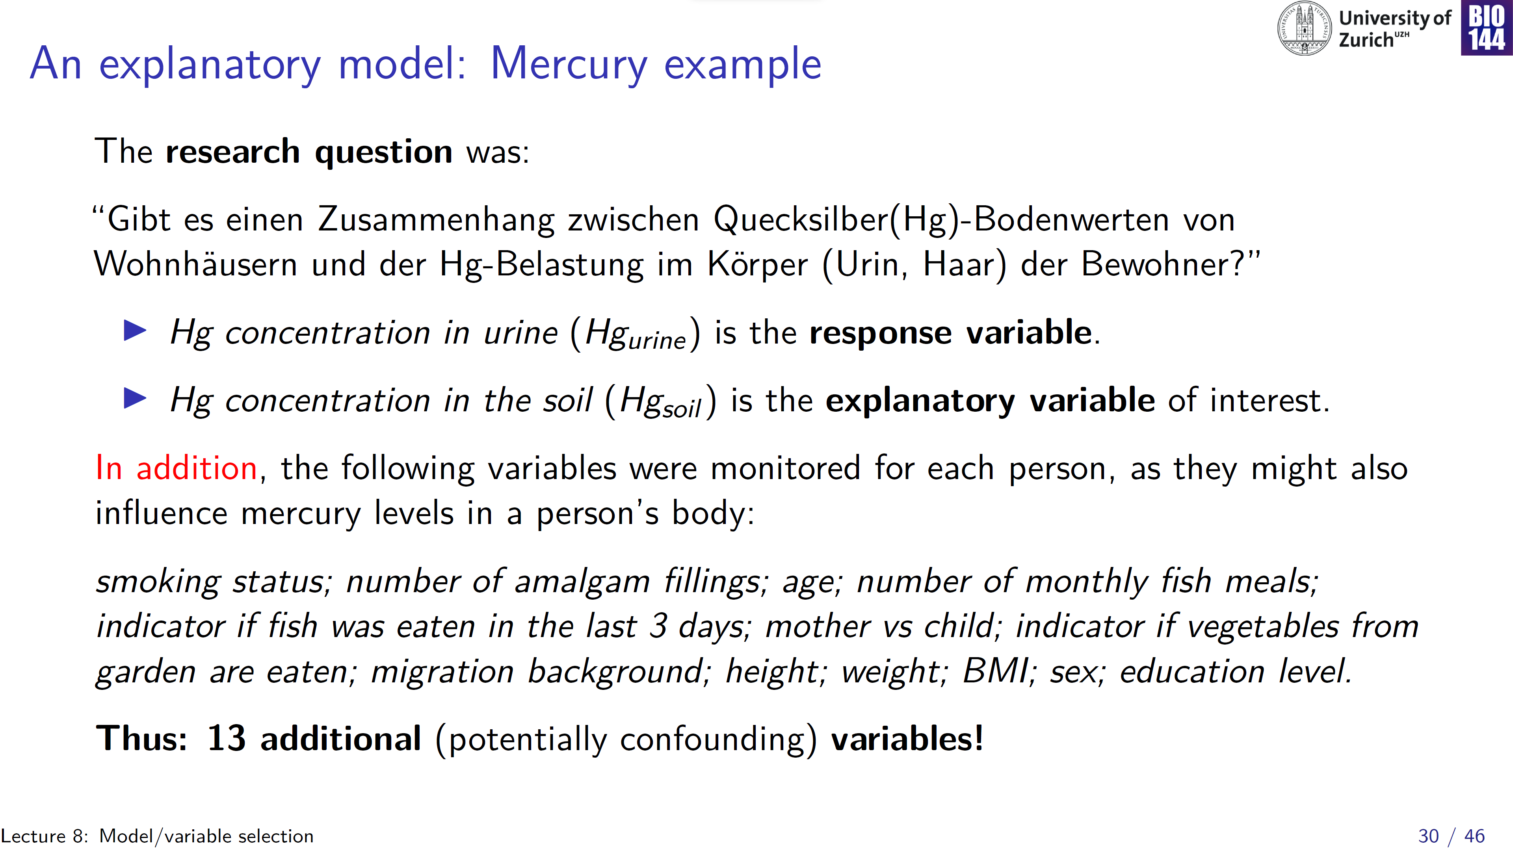

Slide 31
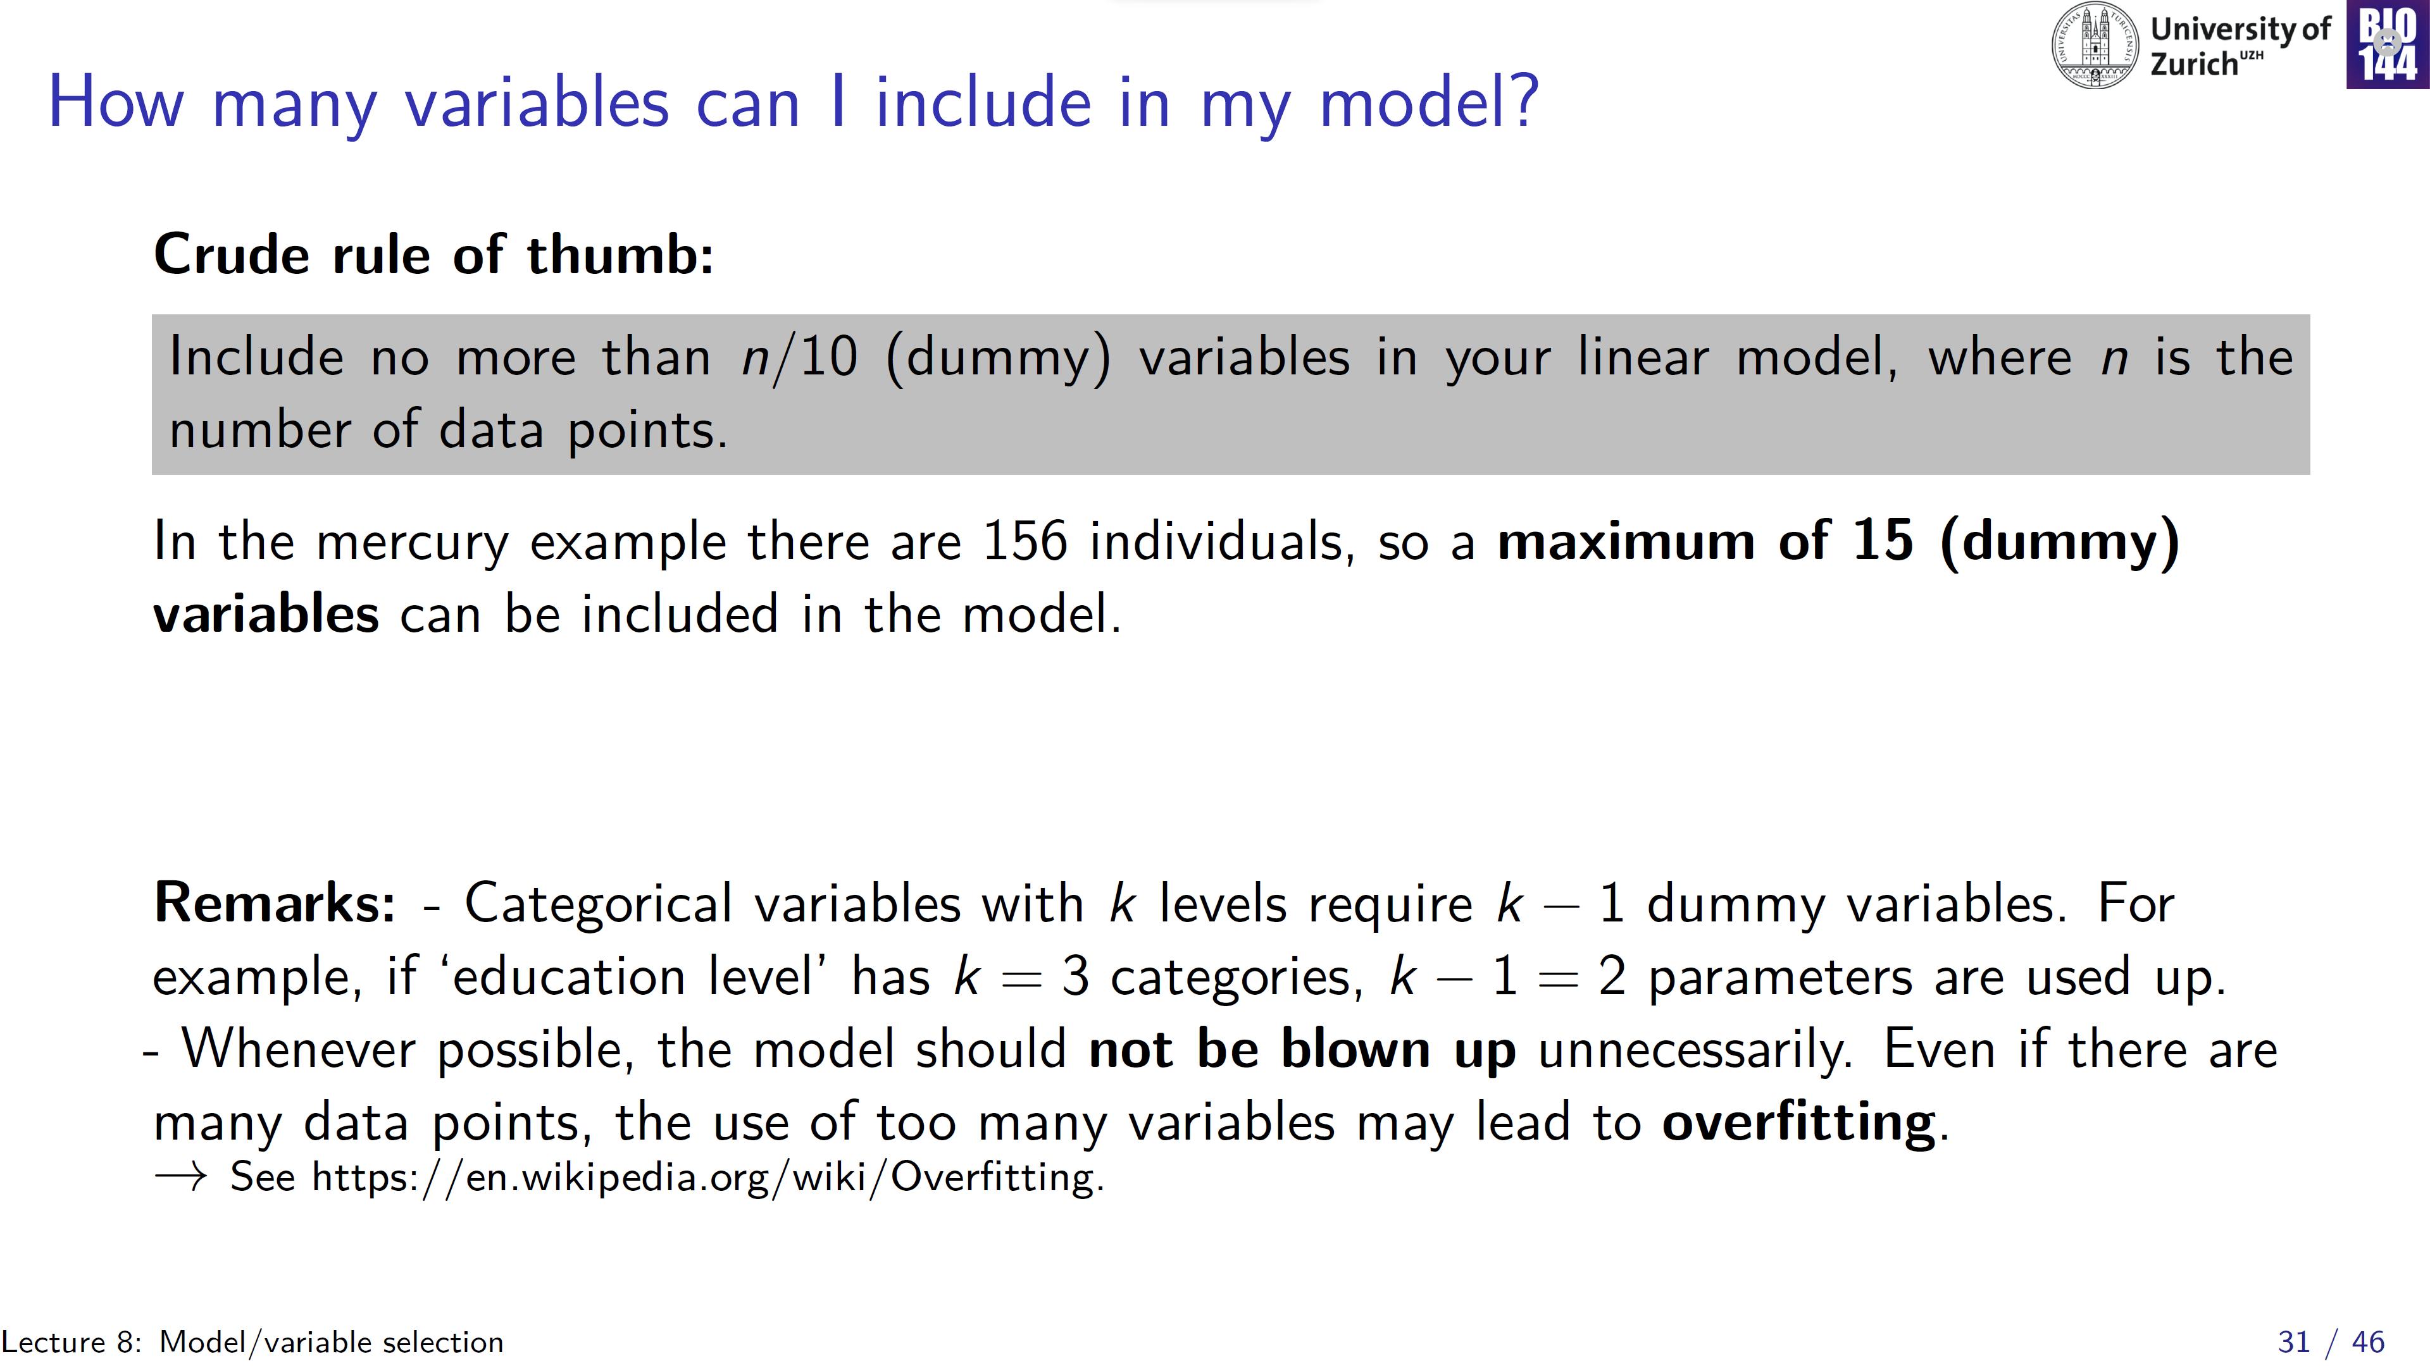
Notes:
Overfitting: your model will fit to “noise” that is specific to your data, rather than fit to the general pattern or “signal”

Slide 32
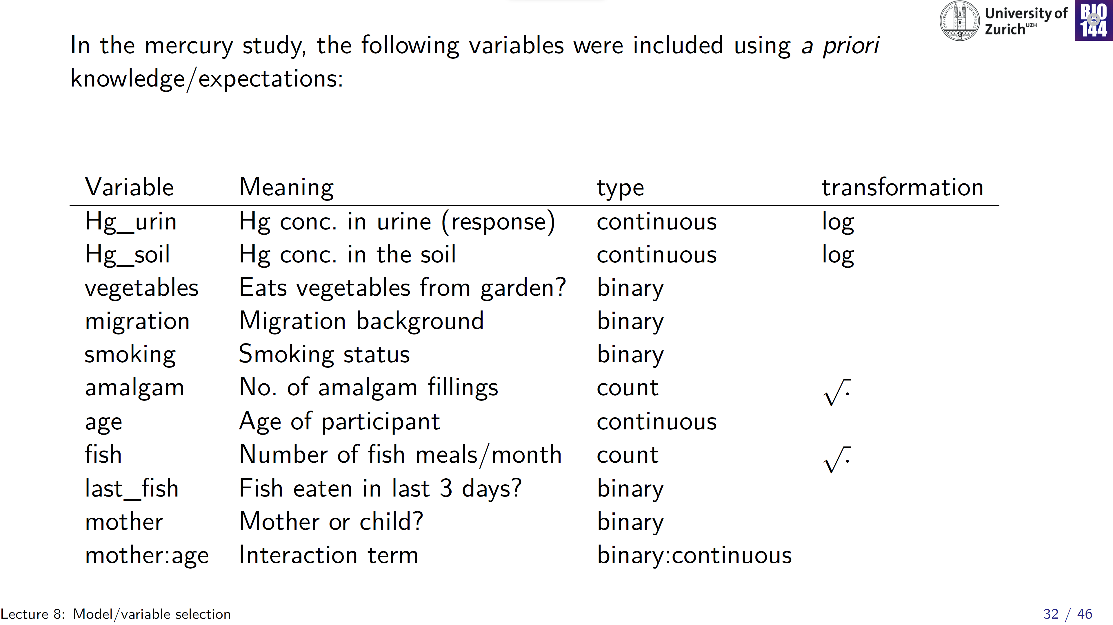

Slide 33
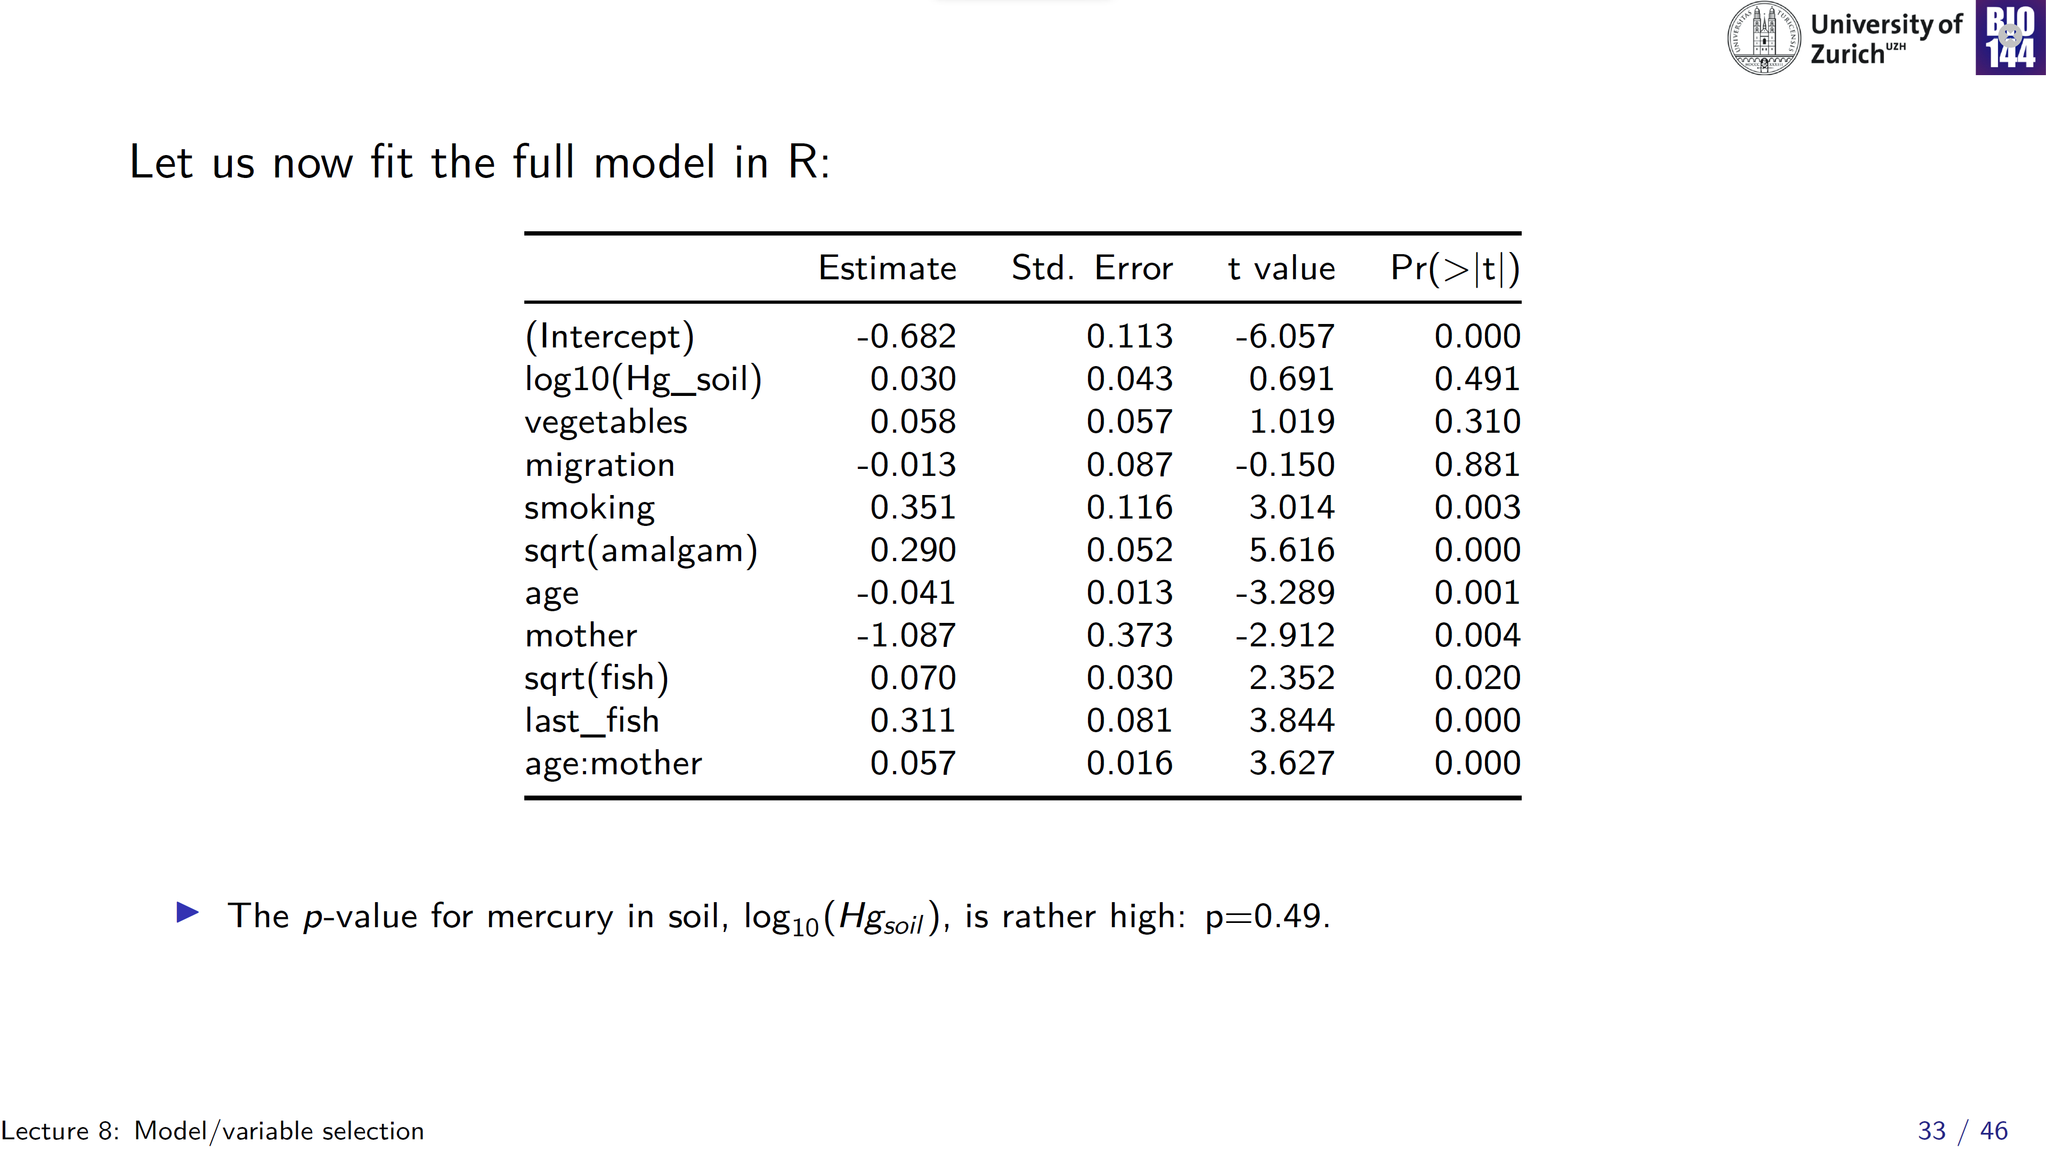
You can interpret this table…
… but first validate the model!
Notes:
So, the model does not yield support for the hypothesis that mercury in soil is associated with mercury in people

Slide 34
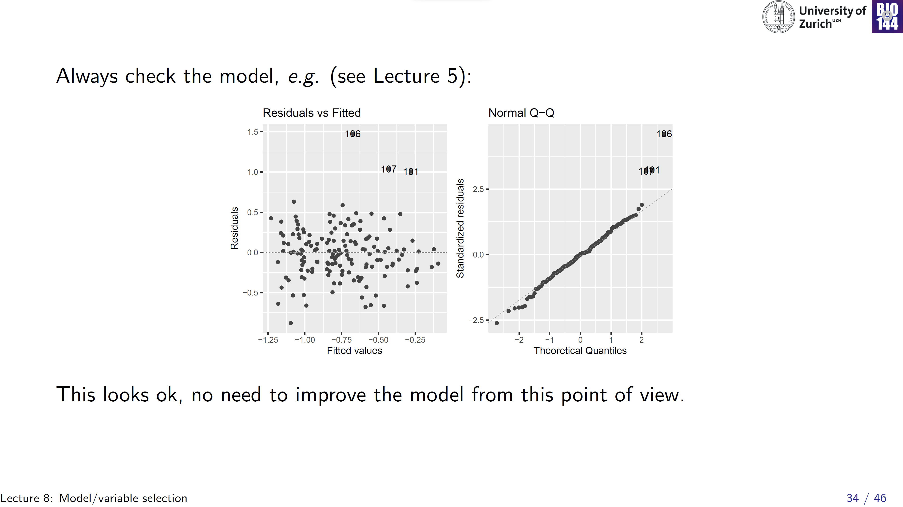
Notes:
Maybe three data points that we want to have a closer look at again (quite high observed values), but overall this looks okay

Slide 35
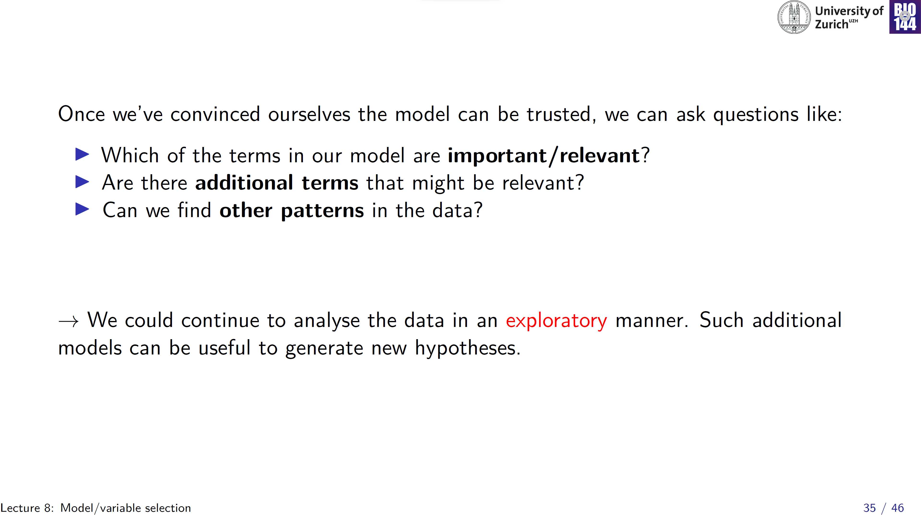

Slide 36
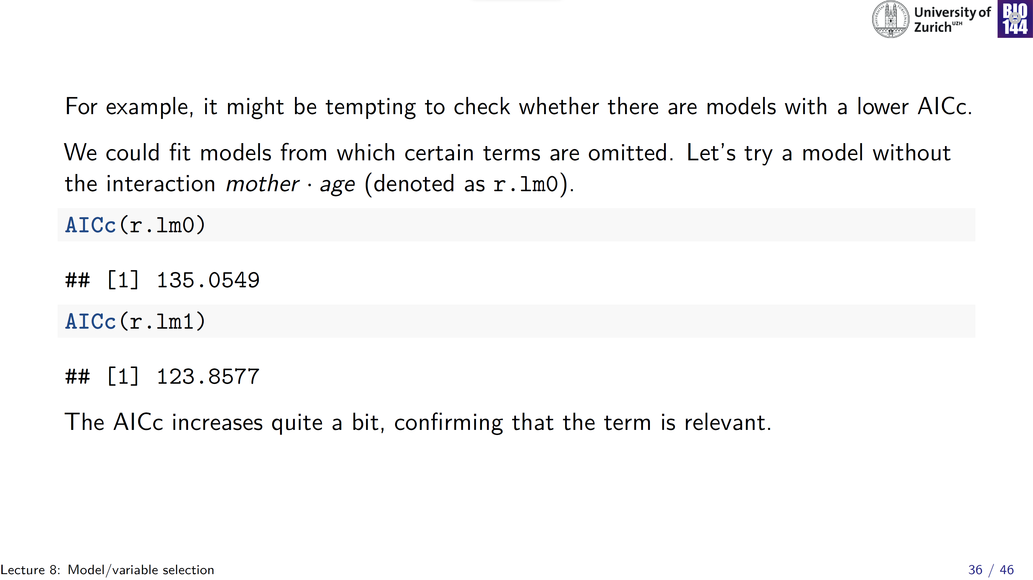
Notes:
So, perhaps in the future, we anticipate that we might be wanting to formulate a model that is to be used for prediction purposes

Slide 37
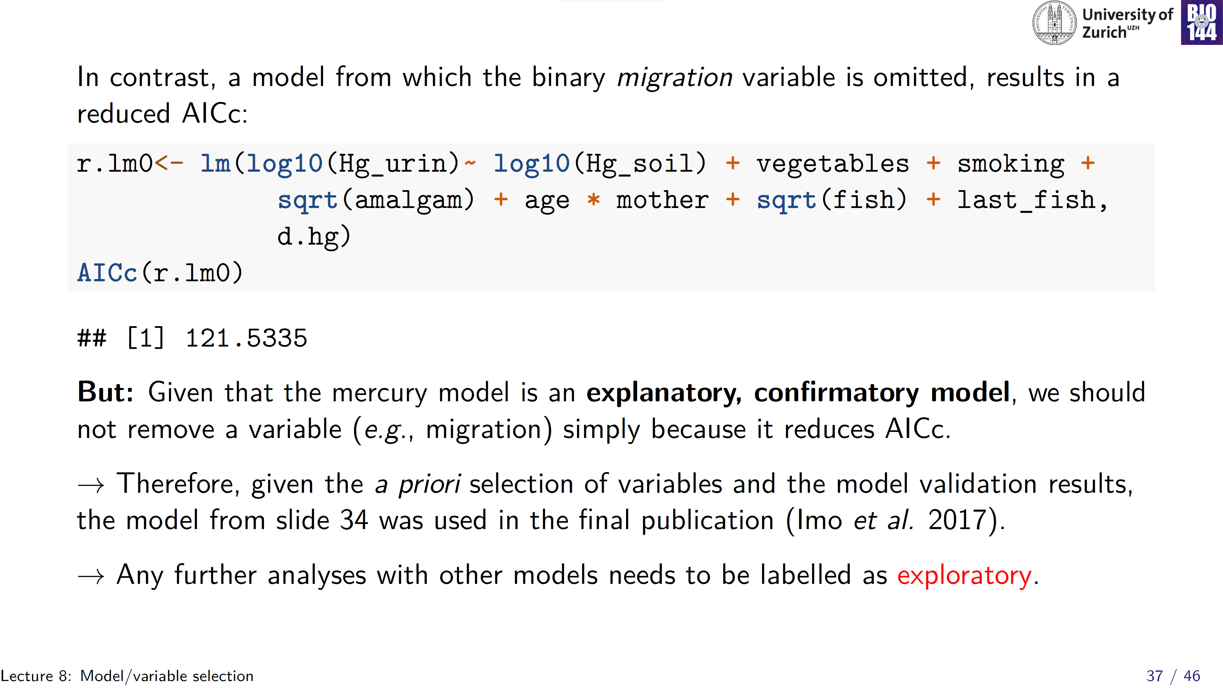

Slide 38
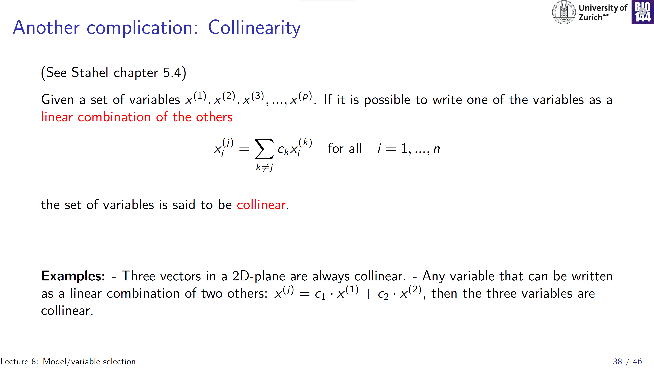
Basically: avoid including explanatory variables that are strongly correlated
Notes:
I don’t find these examples very enlightening… basically, avoid including explanatory variables that are too strongly correlated amongst themselves

Slide 39
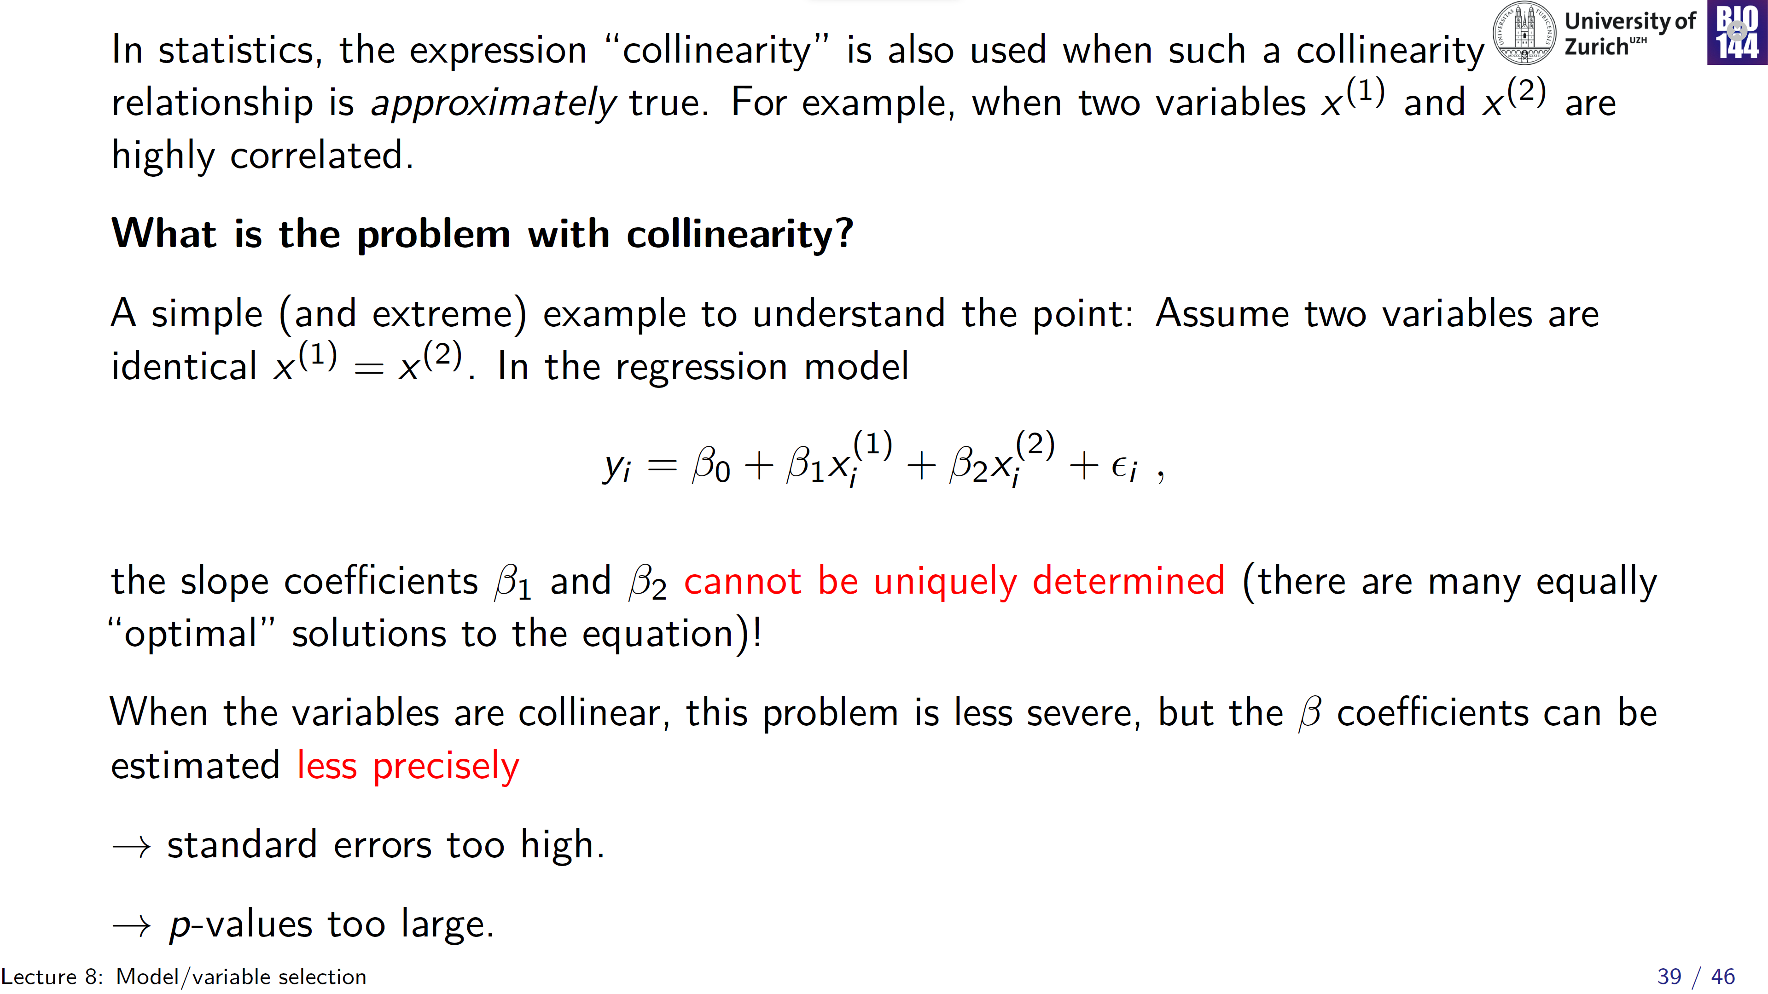
e.g. r _{Pearson} > 0.7
Notes:
This can effect one or more collinear explanatory variables, so in general p-values behave erratic!

Slide 40
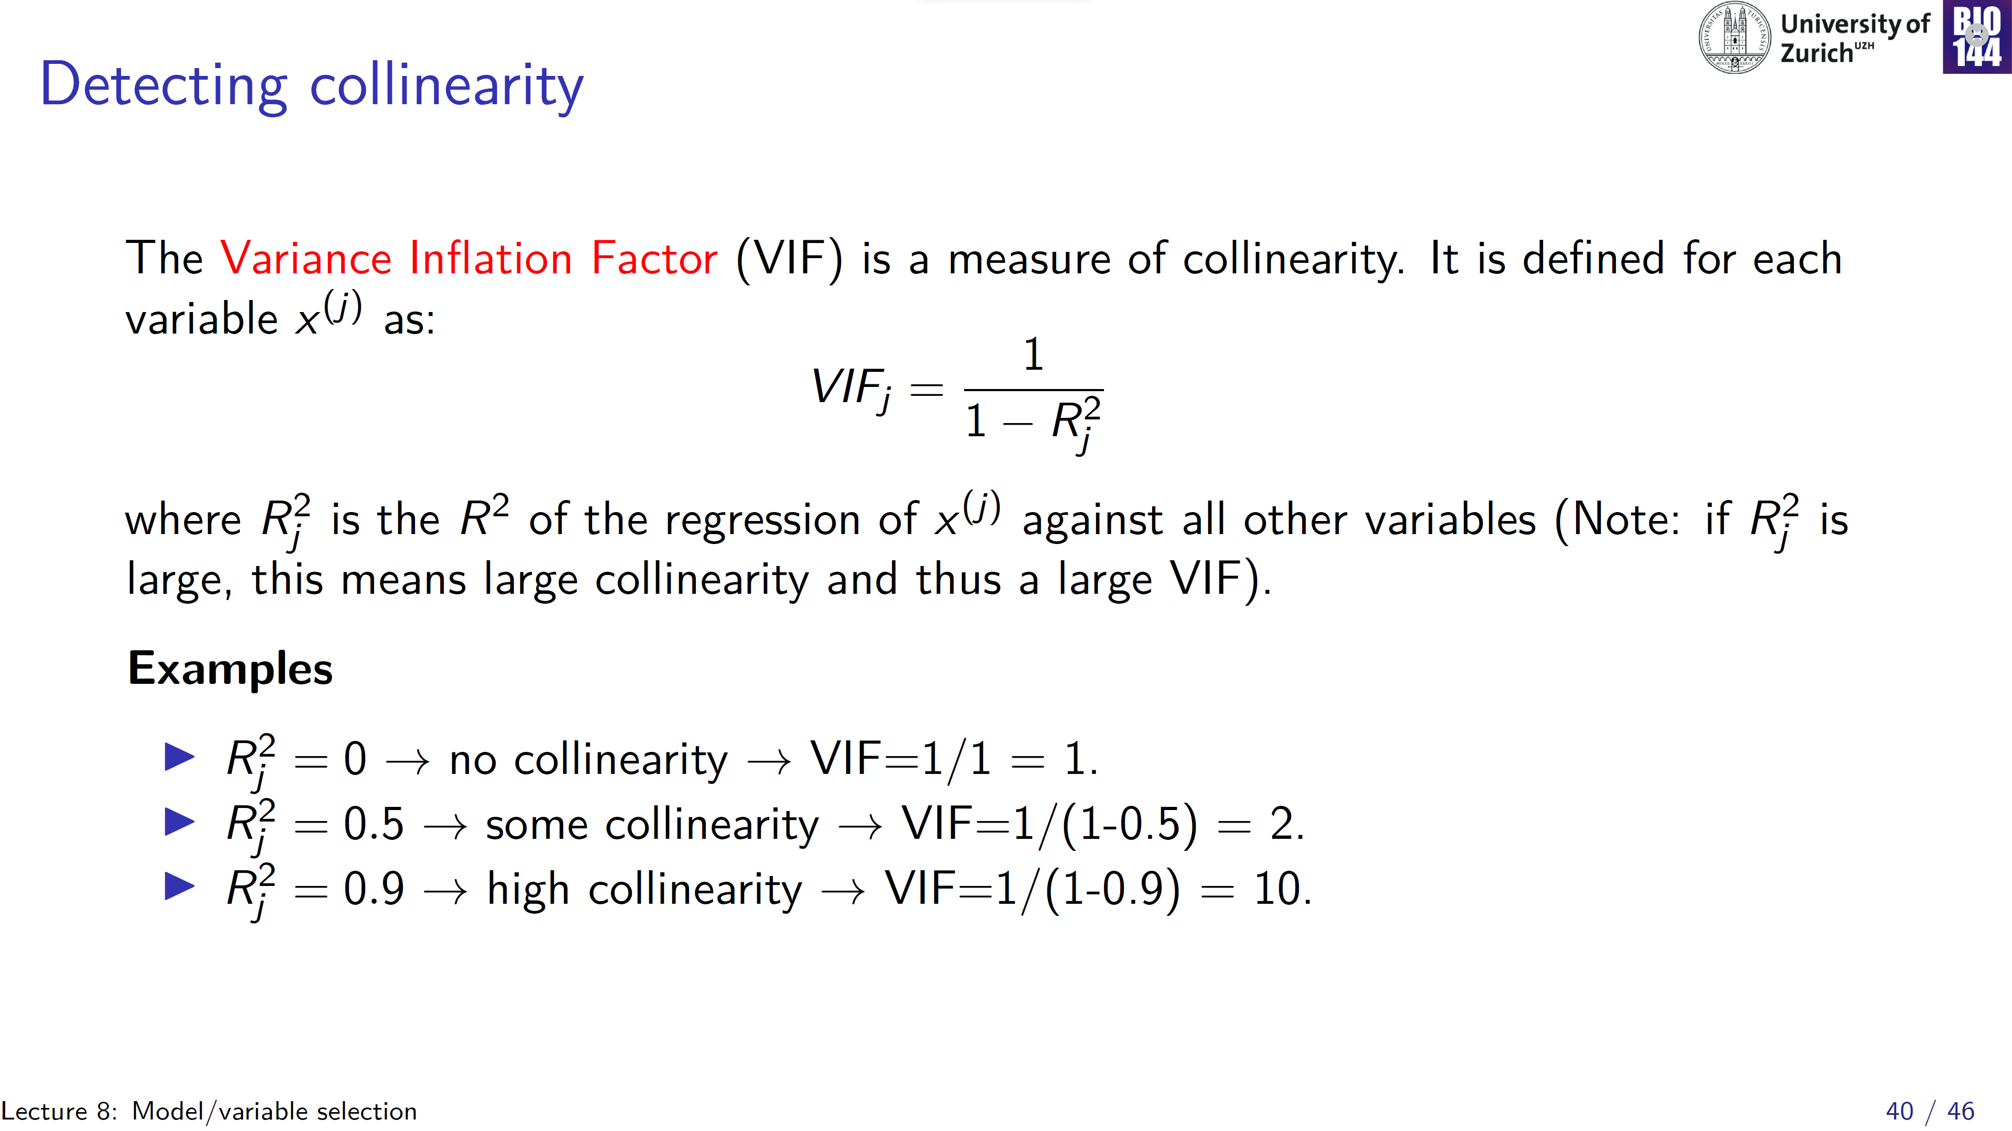
(vif()-function in R)

Slide 41
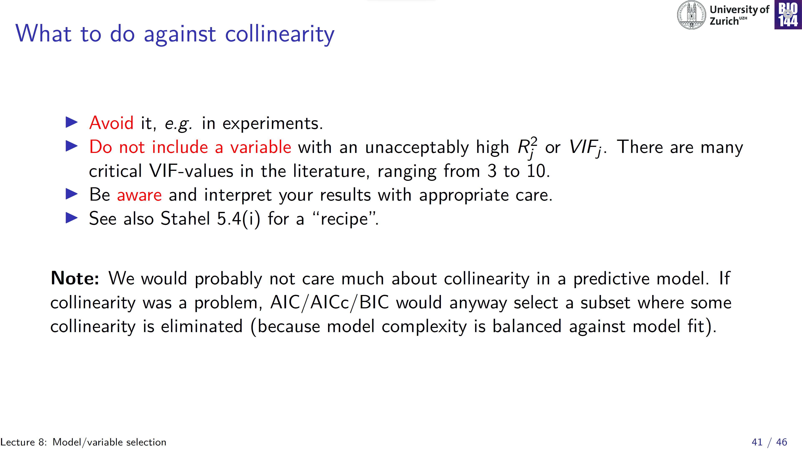

Slide 42
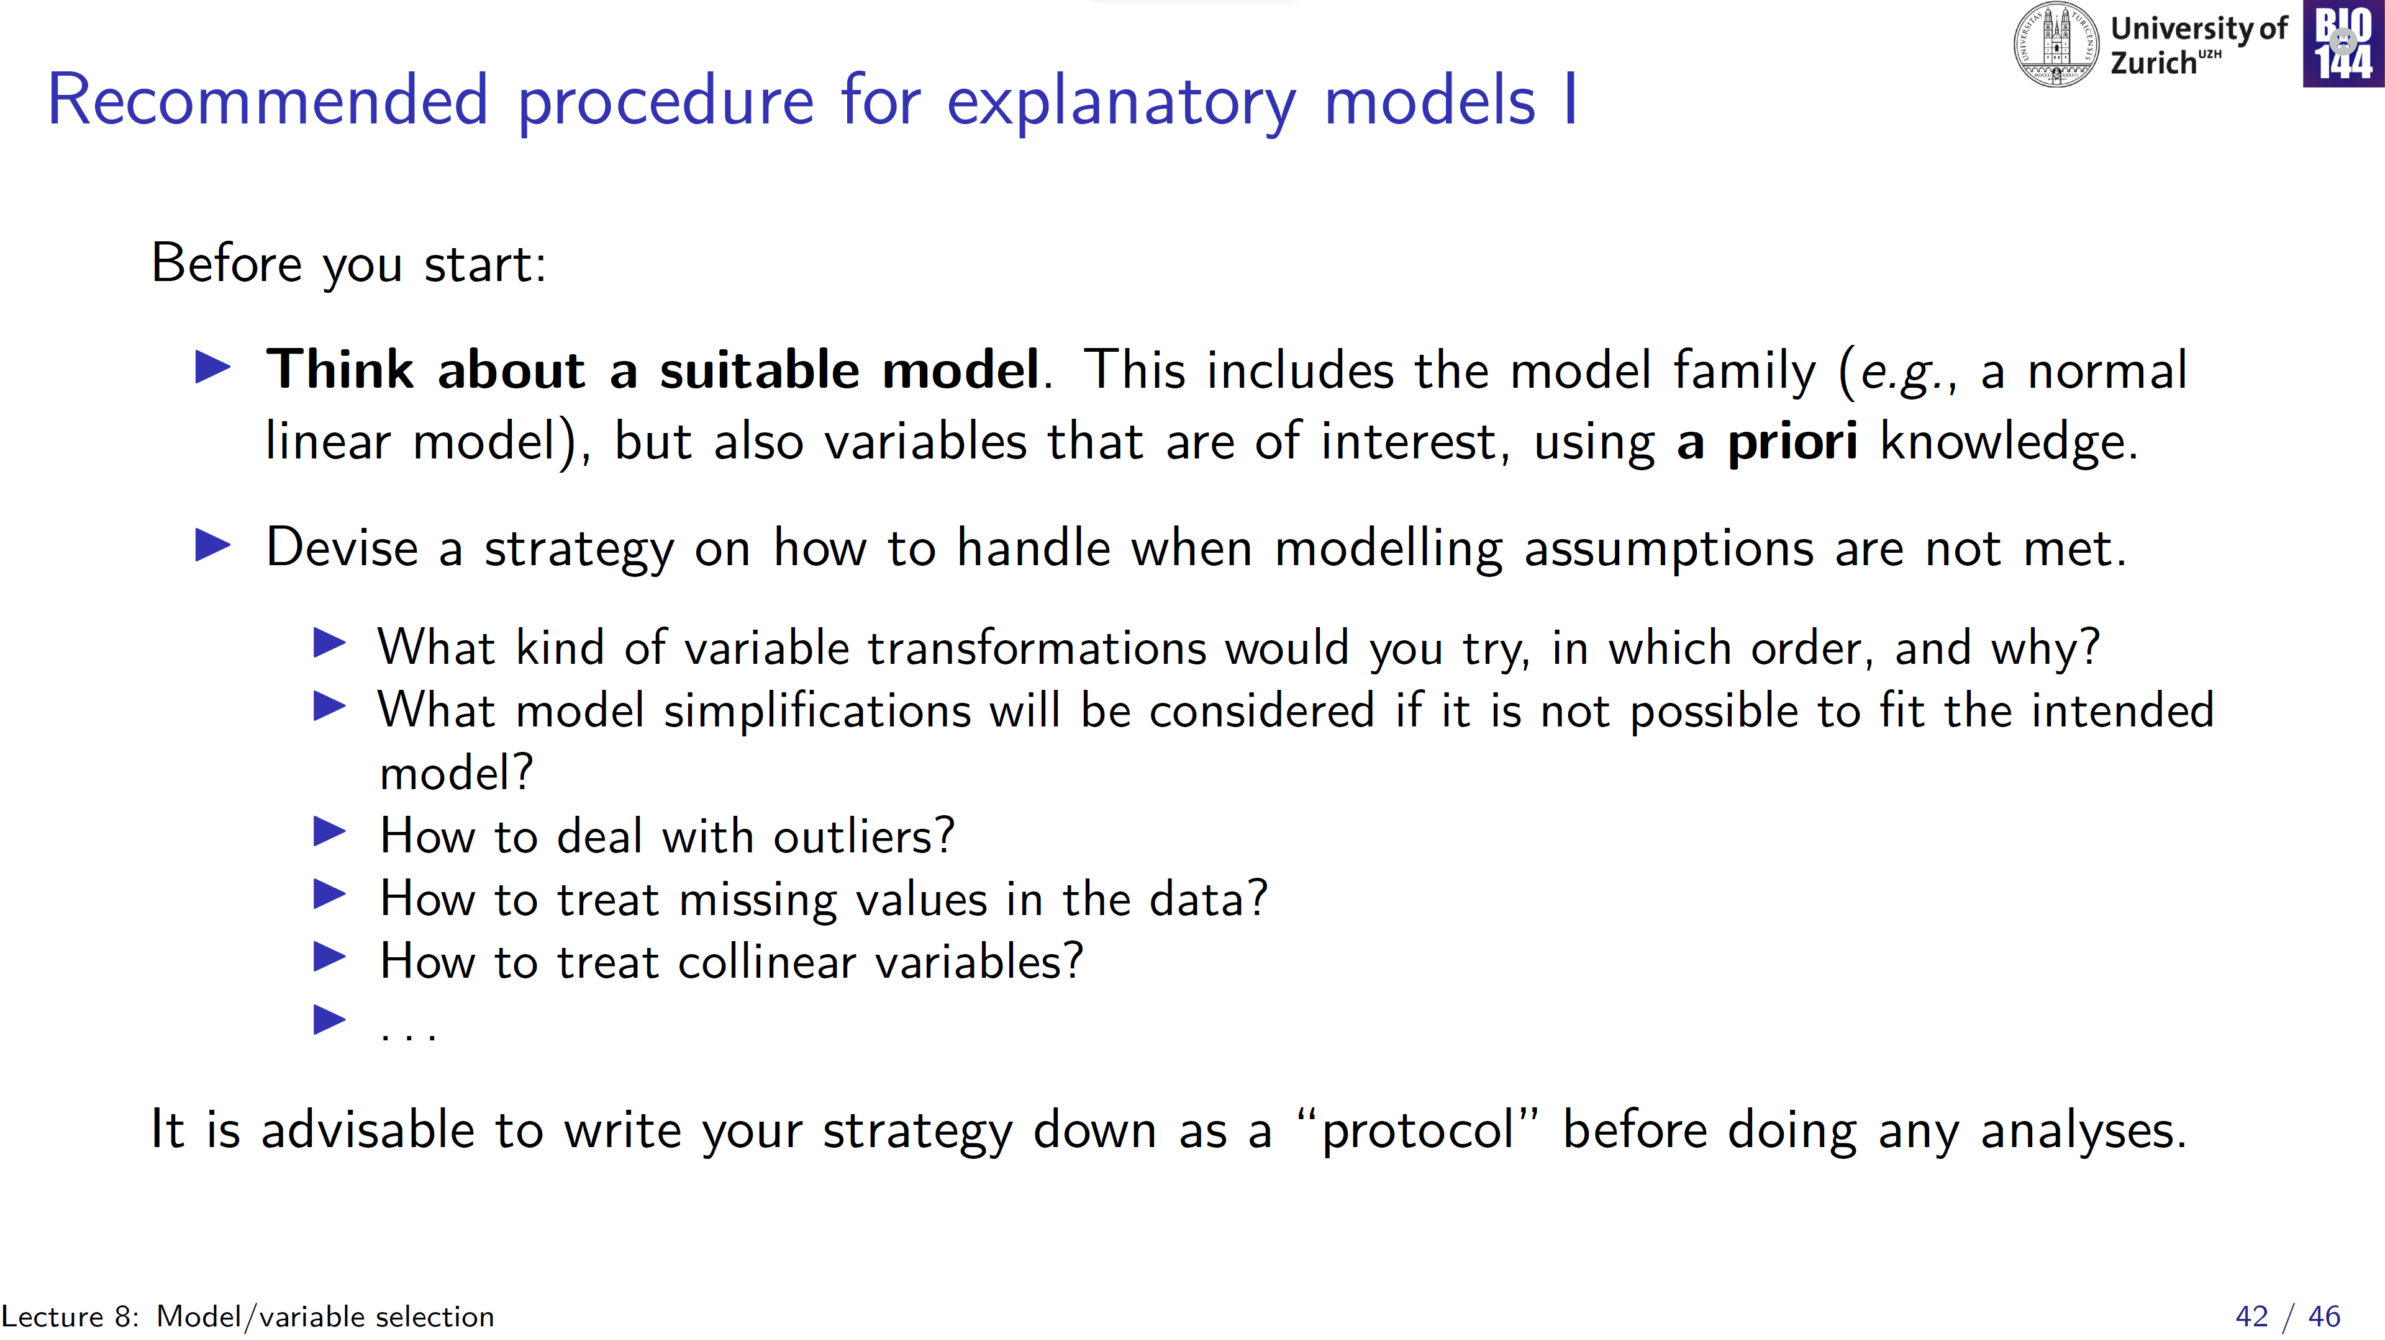
Notes:
IN clinical studies it’s mandatory to write a Statistical Analysis Plan prior to any study!

Slide 43
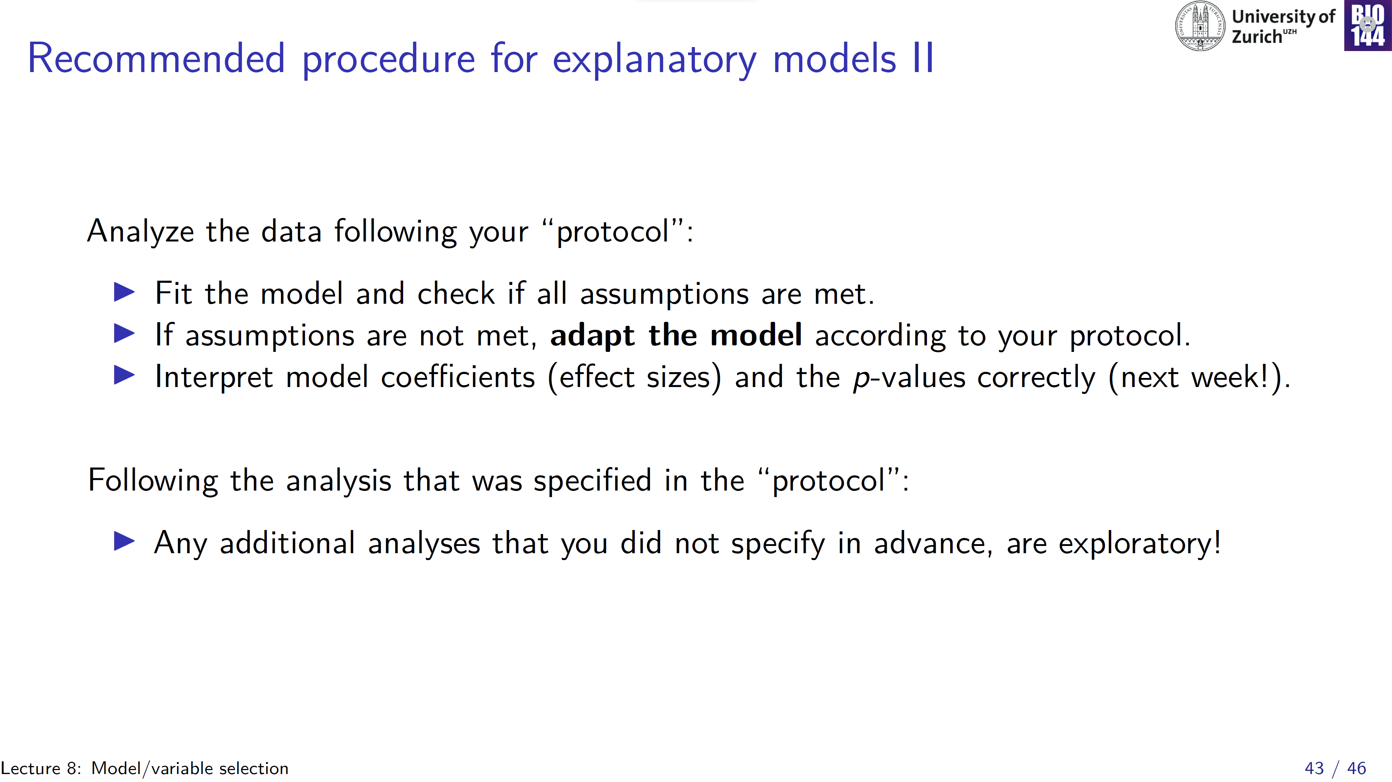

Slide 44
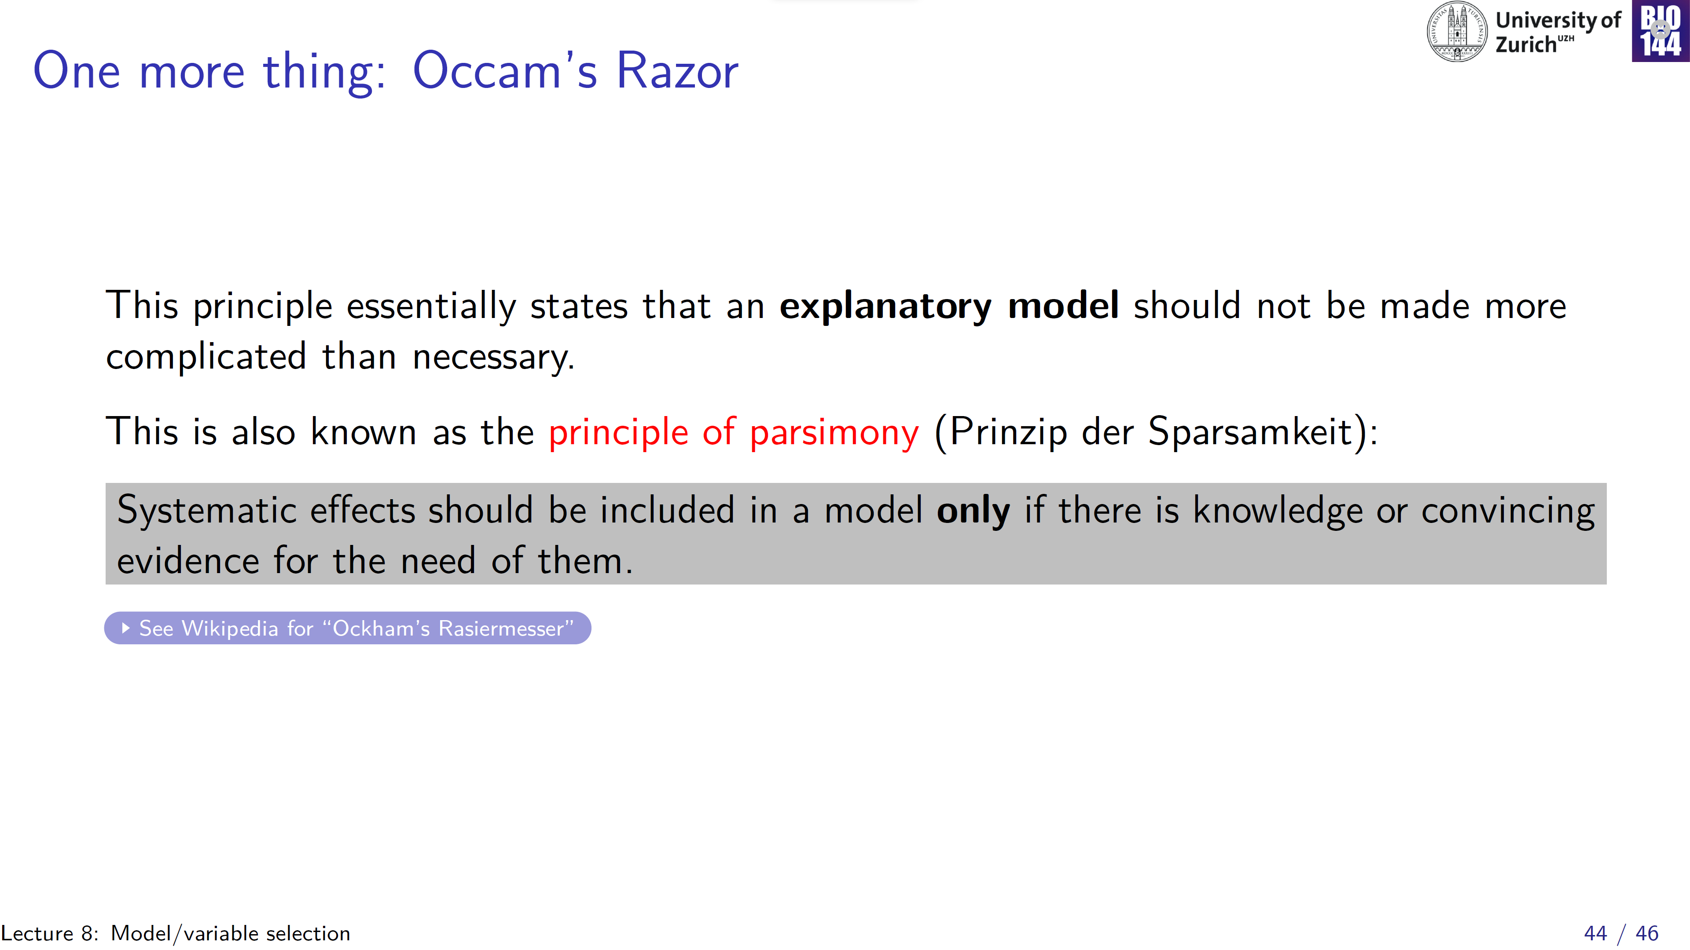
“Keep things as simple as possible, but not simpler”

Slide 45
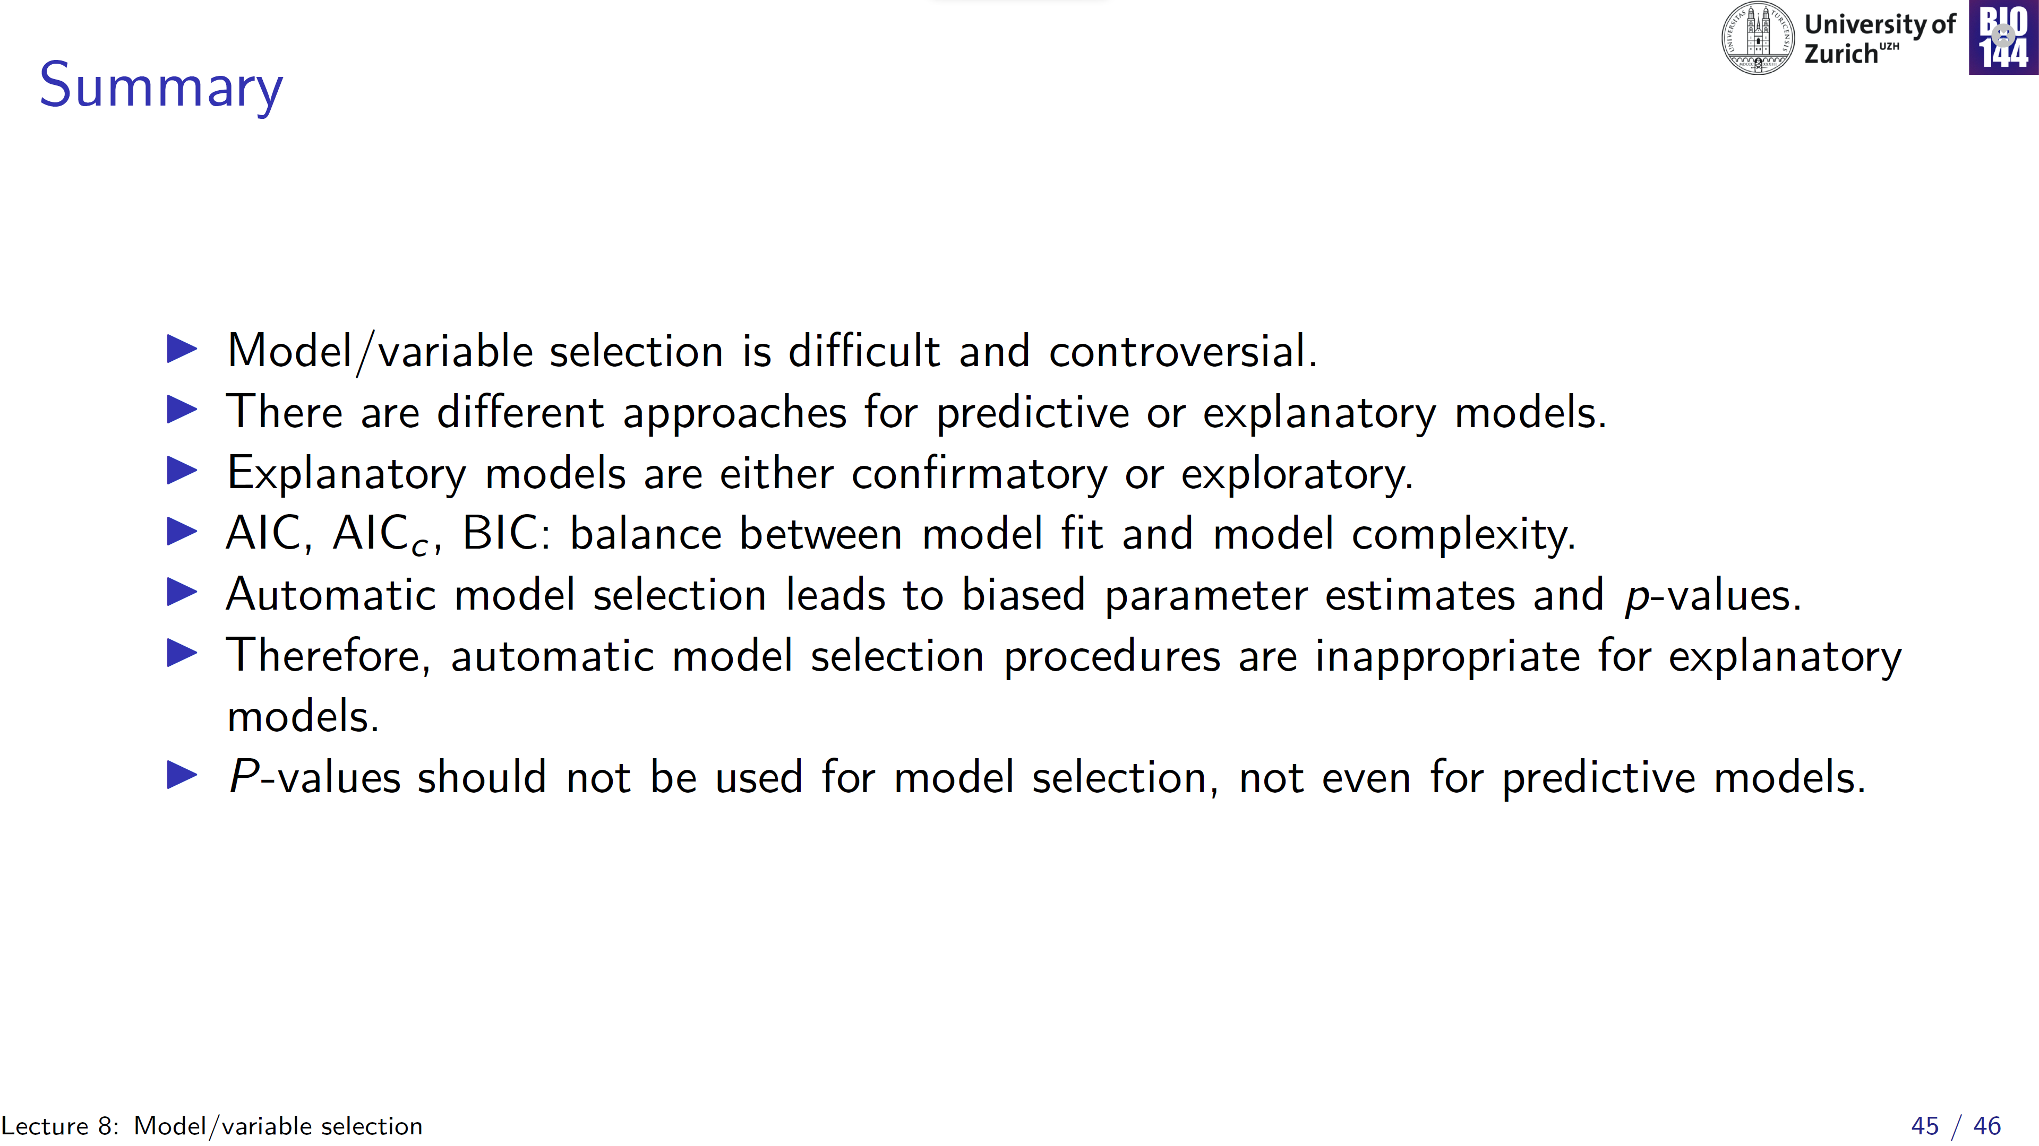

Slide 46
